Slide 1
Observability
Lecturer: Ngo Huy Bien
Software Engineering Department
Faculty of Information Technology
VNUHCM - University of Science
Ho Chi Minh City, Vietnam
nhbien@fit.hcmus.edu.vn

Slide 2

Objectives

Slide 3

Contents
Prometheus
Grafana
Elastic Observability

Slide 4

References
Julien Pivotto and Brian Brazil (2023). Prometheus - Up & Running. O'Reilly.

Slide 5
Prometheus
https://prometheus.io/docs/introduction/overview/
Prometheus is an open-source systems monitoring and alerting toolkit.
Prometheus collects and stores its metrics as time series data, i.e. metrics information is stored with the timestamp at which it was recorded, alongside optional key-value pairs called labels.

Slide 6
Prometheus's Features
A multi-dimensional data model with time series data identified by metric name and key/value pairs.
PromQL, a flexible query language to leverage this dimensionality.
No reliance on distributed storage; single server nodes are autonomous.
Time series collection happens via a pull model over HTTP.
Pushing time series is supported via an intermediary gateway.

Slide 7
Prometheus [1]
Prometheus is an open source, metrics-based monitoring system.
At the end of the day, most monitoring is about the same thing: events.
As a metrics-based monitoring system, Prometheus is designed to track overall system health, behavior, and performance rather than individual events.

Slide 8
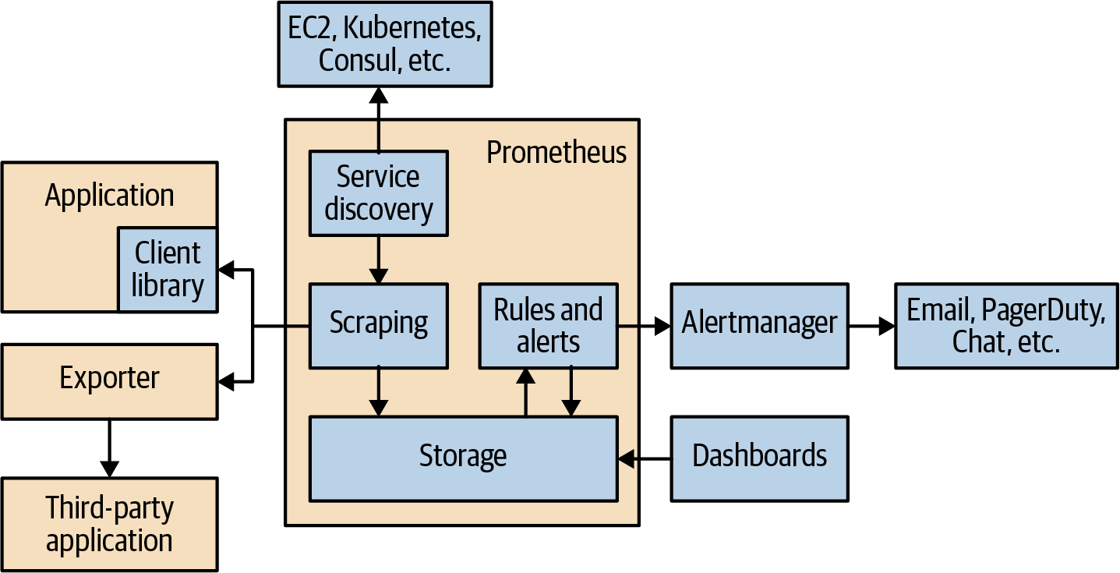
Prometheus Architecture

Slide 9
Prometheus Components (I)
Client Libraries. Metrics do not typically magically spring forth from applications; someone has to add the instrumentation that produces them.
Exporters. Not all code you run is code that you can control or even have access to, and thus adding direct instrumentation isn’t really an option. For example, it is unlikely that operating system kernels will start outputting Prometheus-formatted metrics over HTTP anytime soon.
An exporter is a piece of software that you deploy right beside the application you want to obtain metrics from. It takes in requests from Prometheus, gathers the required data from the application, transforms it into the correct format, and finally returns it in a response to Prometheus.

Slide 10
Prometheus Components (II)
Service Discovery. Once you have all your applications instrumented and your exporters running, Prometheus needs to know where they are. This is so Prometheus will know what to monitor, and be able to notice if something it is meant to be monitoring is not responding.
With dynamic environments you cannot simply provide a list of applications and exporters once, as it will get out of date.
Prometheus has integrations with many common service discovery mechanisms, such as Kubernetes, EC2, and Consul.
As every organization does it slightly differently, Prometheus allows you to configure how metadata from service discovery is mapped to monitoring targets and their labels using relabeling.

Slide 11
Prometheus Components (III)
Scraping. Service discovery and relabeling give us a list of targets to be monitored.
Now Prometheus needs to fetch the metrics. Prometheus does this by sending an HTTP request called a scrape.
The response to the scrape is parsed and ingested into storage.
Several useful metrics are also added in, such as if the scrape succeeded and how long it took.
Scrapes happen regularly; usually you would configure it to happen every 10 to 60 seconds for each target.

Slide 12
Prometheus Components (IV)
Storage. Prometheus stores data locally in a custom database.
Distributed systems are challenging to make reliable, so Prometheus does not attempt to do any form of clustering.
The storage system can handle ingesting millions of samples per second, making it possible to monitor thousands of machines with a single Prometheus server.
The compression algorithm used can achieve 1.3 bytes per sample on real-world data.
Prometheus does not offer a clustered storage solution to store data across multiple machines, but there are remote read and write APIs that allow other systems to hook in and take on this role.

Slide 13
Prometheus Components (V)
Dashboards. It is recommended that you use Grafana for dashboards. It has a wide variety of features, including official support for Prometheus as a data source.

Slide 14
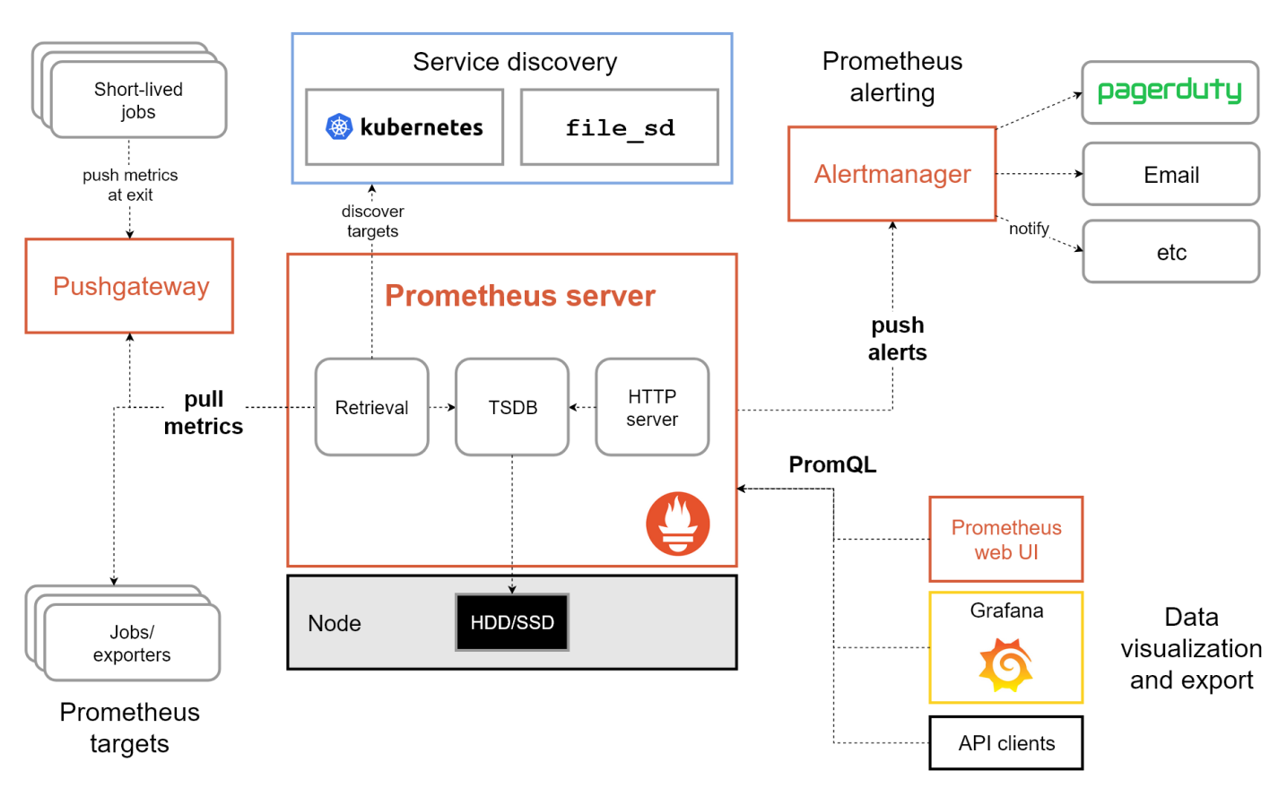
Prometheus's Architecture
https://prometheus.io/docs/introduction/overview/

Slide 15
Notes
As a metrics-based system, Prometheus is not suitable for storing event logs or individual events.
Nor is it the best choice for high-cardinality data, such as email addresses or usernames.
Prometheus is designed for operational monitoring, where small inaccuracies and race conditions due to factors like kernel scheduling and failed scrapes are a fact of life.
Prometheus makes trade-offs and prefers giving you data that is 99.9% correct over your monitoring breaking while waiting for perfect data.
Thus in applications involving money or billing, Prometheus should be used with caution.

Slide 16
Disadvantages
Basic deployment Prometheus is a single point of failure.
Common mitigation strategies
Two independent servers scrape the same targets.
One server scrapes other Prometheus instances to provide aggregated or global views.
Tools like Cortex, Thanos, or Mimir add replication, long-term storage, and HA for metrics by pushing data into object stores or clusters, removing reliance on one node's disk.

Slide 17


Slide 18
1. Run Prometheus on Ubuntu
https://prometheus.io/download/
wget https://github.com/prometheus/prometheus/releases/download/v3.5.0/prometheus-3.5.0.linux-amd64.tar.gz
tar -xzf prometheus-*.linux-amd64.tar.gz
cd prometheus-*.linux-amd64/
nano prometheus.yml
# The Prometheus ecosystem uses YAML (YAML Ain’t Markup Language) for its configuration files.
./prometheus --web.listen-address="0.0.0.0:9090"

Slide 19
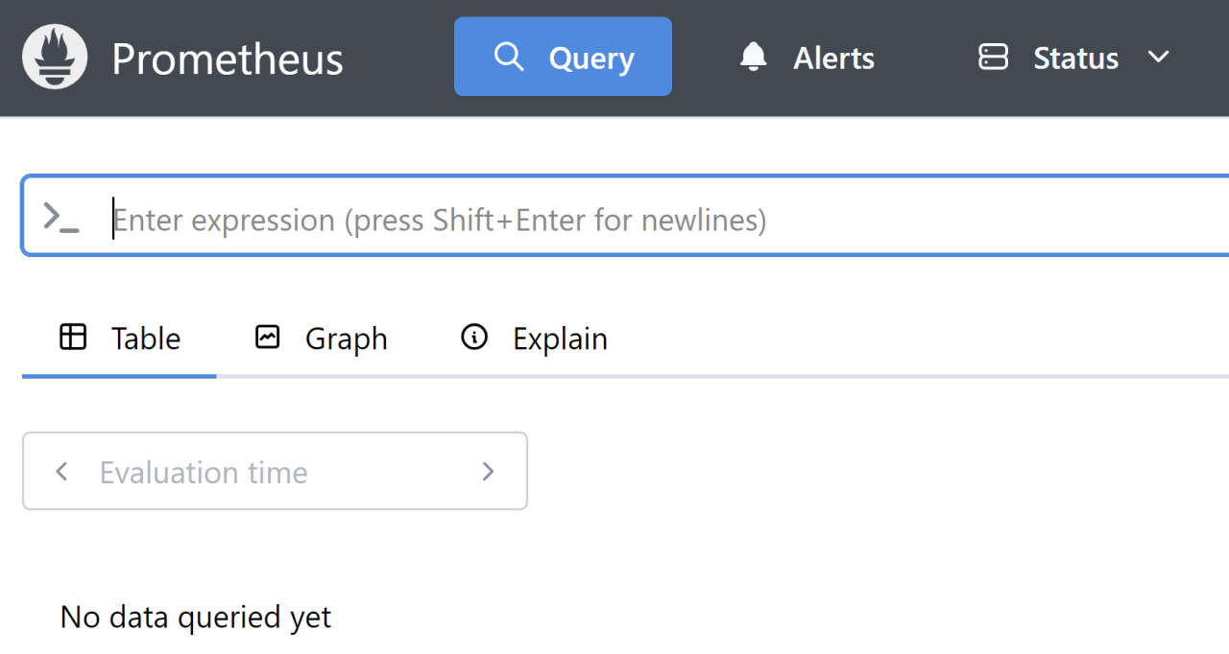
2. Open the Expression Browser
http://20.253.214.16:9090/query
This is the expression browser from which you can run PromQL queries.

Slide 20
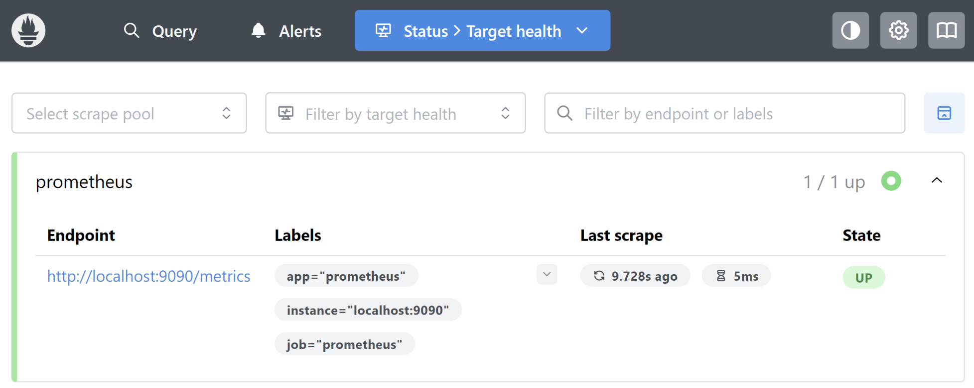
3. Open the Targets Page
http://20.253.214.16:9090/targets
On this page there is only a single Prometheus server in the UP state, meaning that the last scrape was successful.

Slide 21
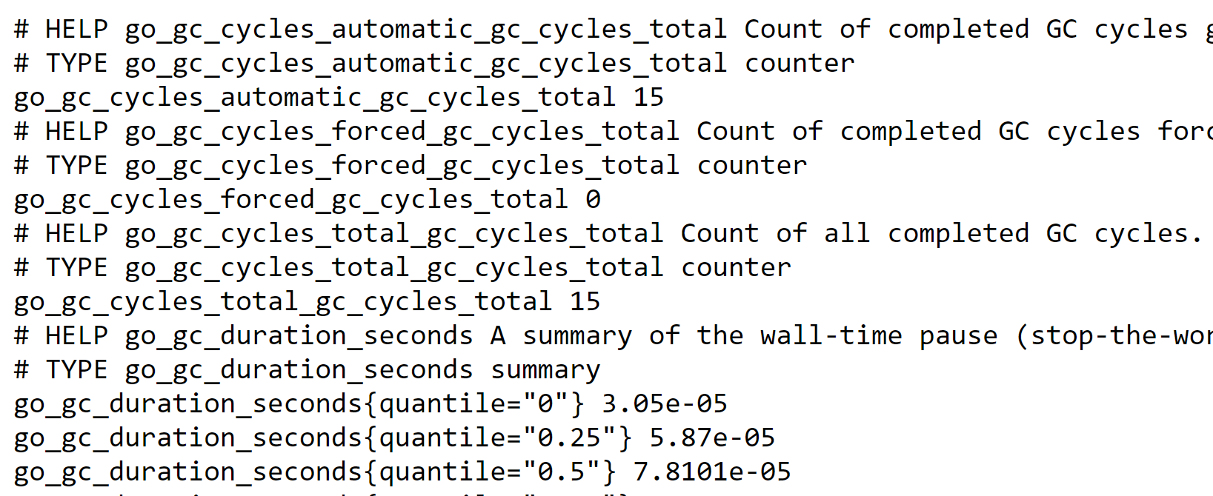
4. Open the Metrics Page
http://20.253.214.16:9090/metrics
Prometheus is itself instrumented with Prometheus metrics.

Slide 22
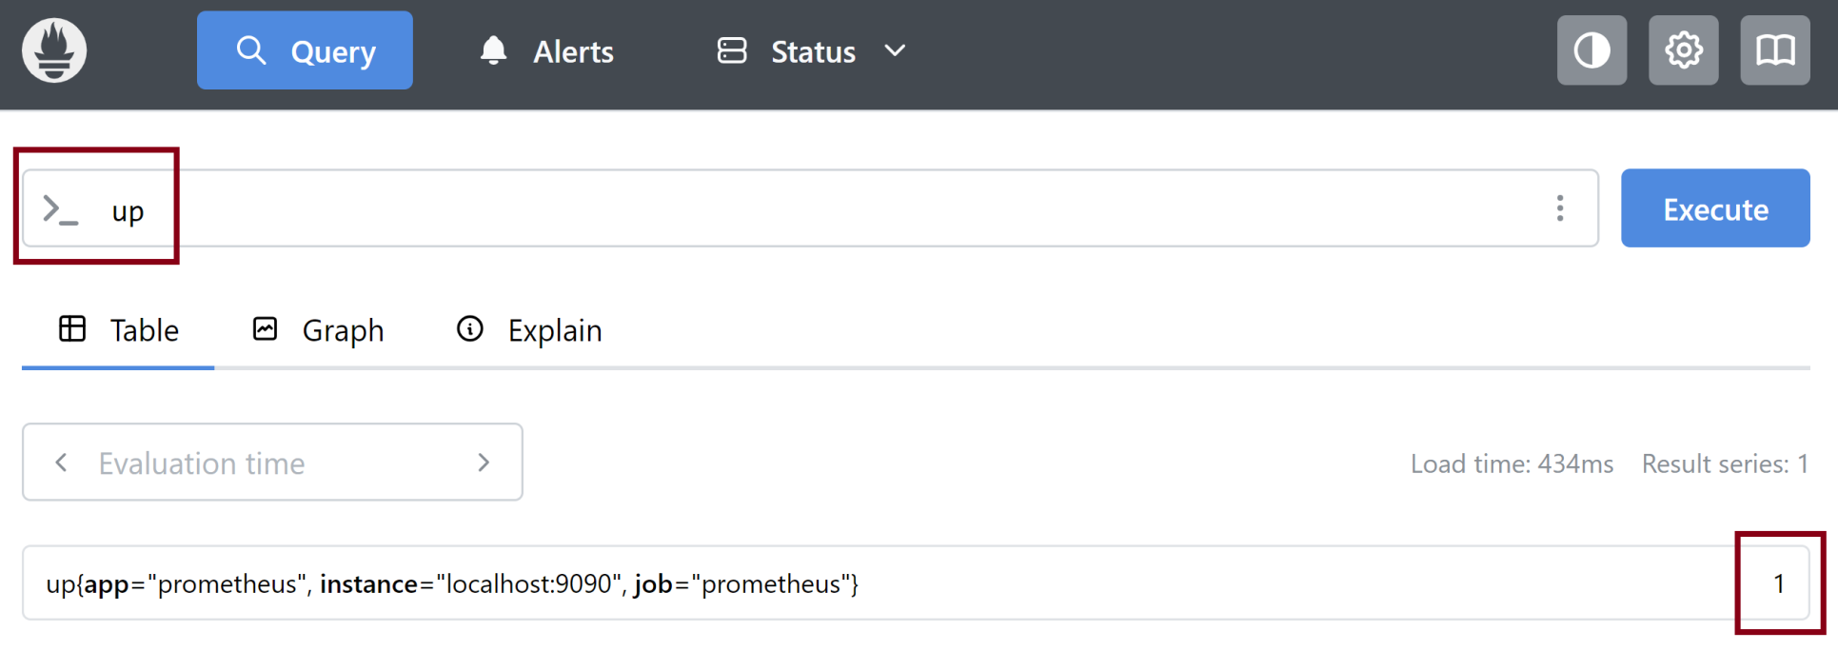
5. Test PromQL Queries
up
( process_resident_memory_bytes / 1024 ) / 1024

Slide 23
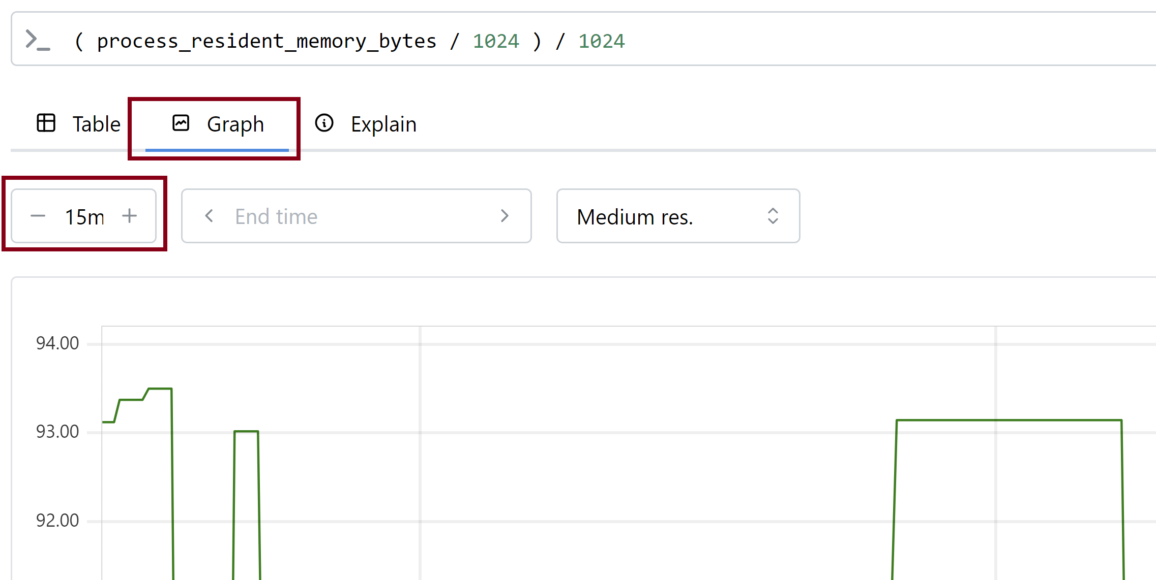
6. View Graph
Metrics like process_resident_memory_bytes are called gauges. A gauge’s current absolute value is what is important to you.

Slide 25
1. Run the Node Exporter
The Node Exporter exposes kernel- and machine-level metrics on Unix systems.
https://prometheus.io/download/
wget https://github.com/prometheus/node_exporter/releases/download/v1.10.2/node_exporter-1.10.2.linux-amd64.tar.gz
tar -xzf node_exporter-*.linux-amd64.tar.gz
cd node_exporter-*.linux-amd64
./node_exporter

Slide 26
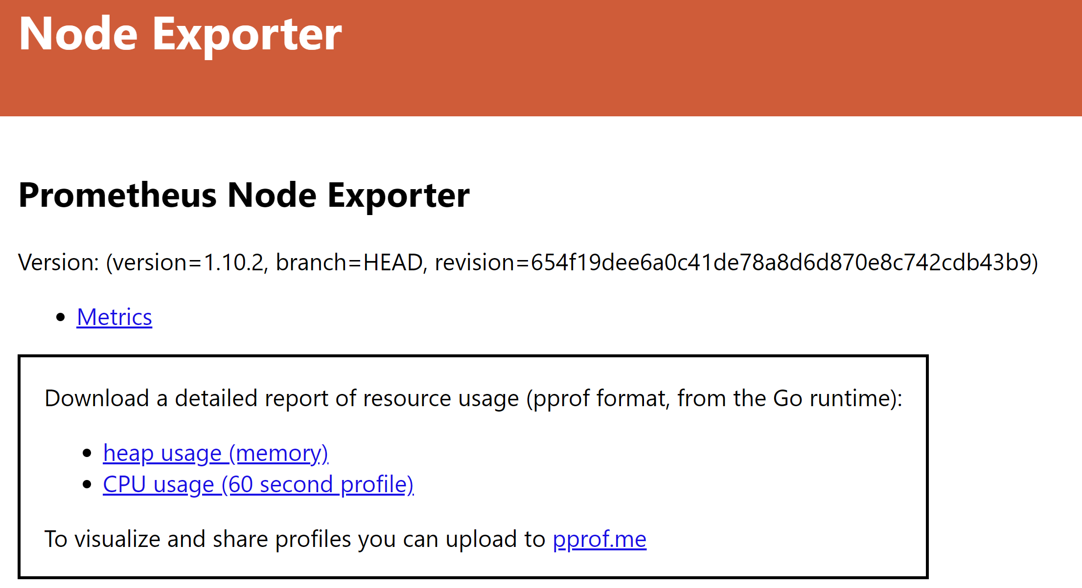
2. Open the Node Exporter
http://20.253.214.16:9100/

Slide 27
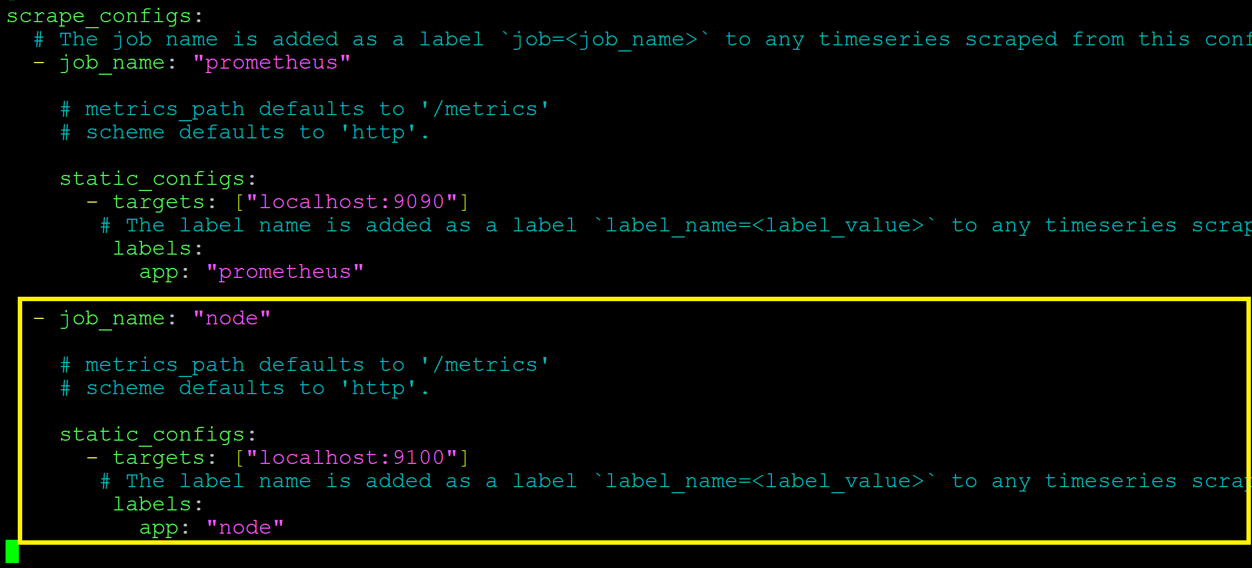
3. Update the prometheus.yml File
nano prometheus.yml
./prometheus --web.listen-address="0.0.0.0:9090"

Slide 28
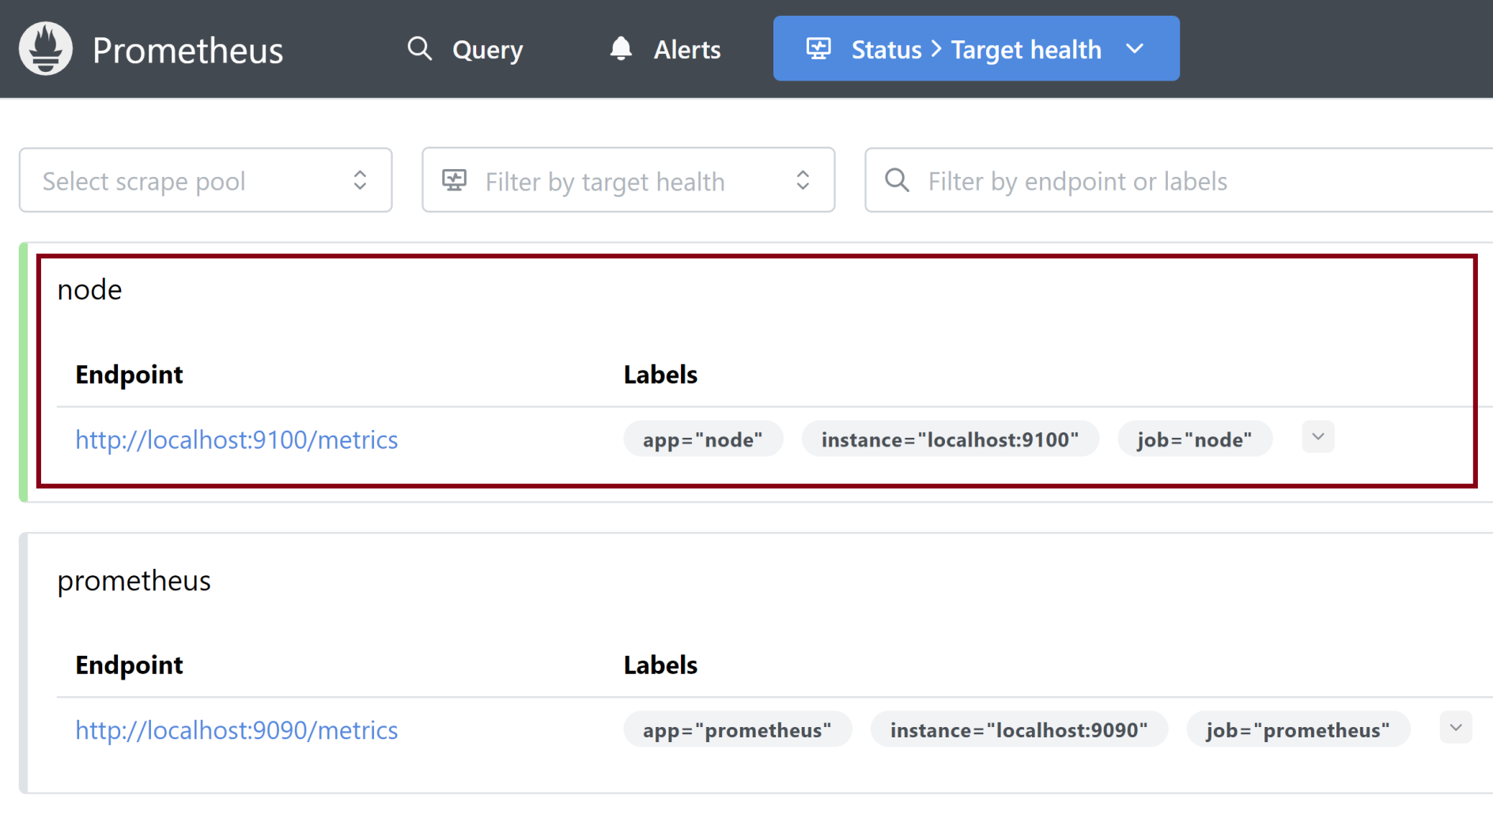
4. View the Targets

Slide 29
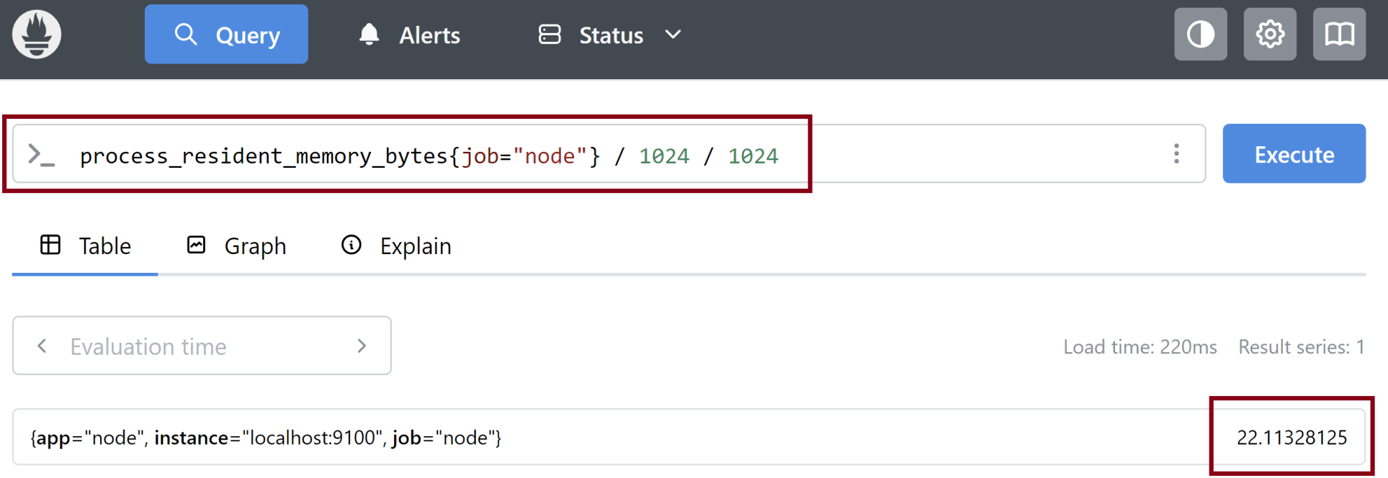
5. Run a Query
process_resident_memory_bytes{job="node"} / 1024 / 1024

Slide 31
Grafana
https://grafana.com/docs/
Query, visualize, and understand your data.

Slide 32
1. Install Grafana on Ubuntu
https://grafana.com/docs/grafana/latest/setup-grafana/installation/debian/
sudo apt-get install -y apt-transport-https wget
sudo mkdir -p /etc/apt/keyrings/
wget -q -O - https://apt.grafana.com/gpg.key | gpg --dearmor | sudo tee /etc/apt/keyrings/grafana.gpg > /dev/null
echo "deb [signed-by=/etc/apt/keyrings/grafana.gpg] https://apt.grafana.com stable main" | sudo tee -a /etc/apt/sources.list.d/grafana.list
sudo apt-get update
sudo apt-get install grafana-enterprise

Slide 33
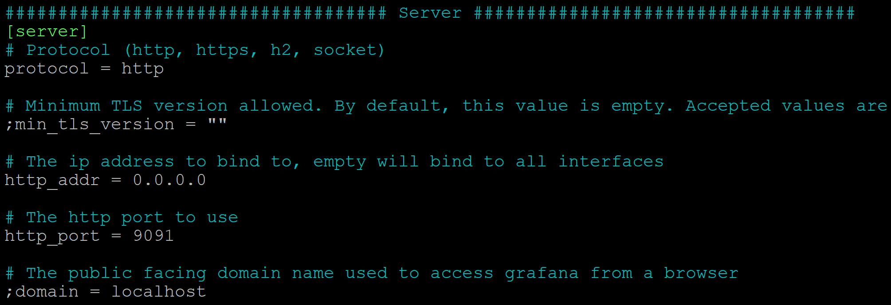
2. Modify the Grafana Settings
sudo nano /etc/grafana/grafana.ini

Slide 34
3. Start the Grafana Server
https://grafana.com/docs/grafana/latest/setup-grafana/start-restart-grafana/
sudo systemctl daemon-reload
sudo systemctl start grafana-server
sudo systemctl status grafana-server
sudo systemctl enable grafana-server.service
sudo systemctl restart grafana-server

Slide 35
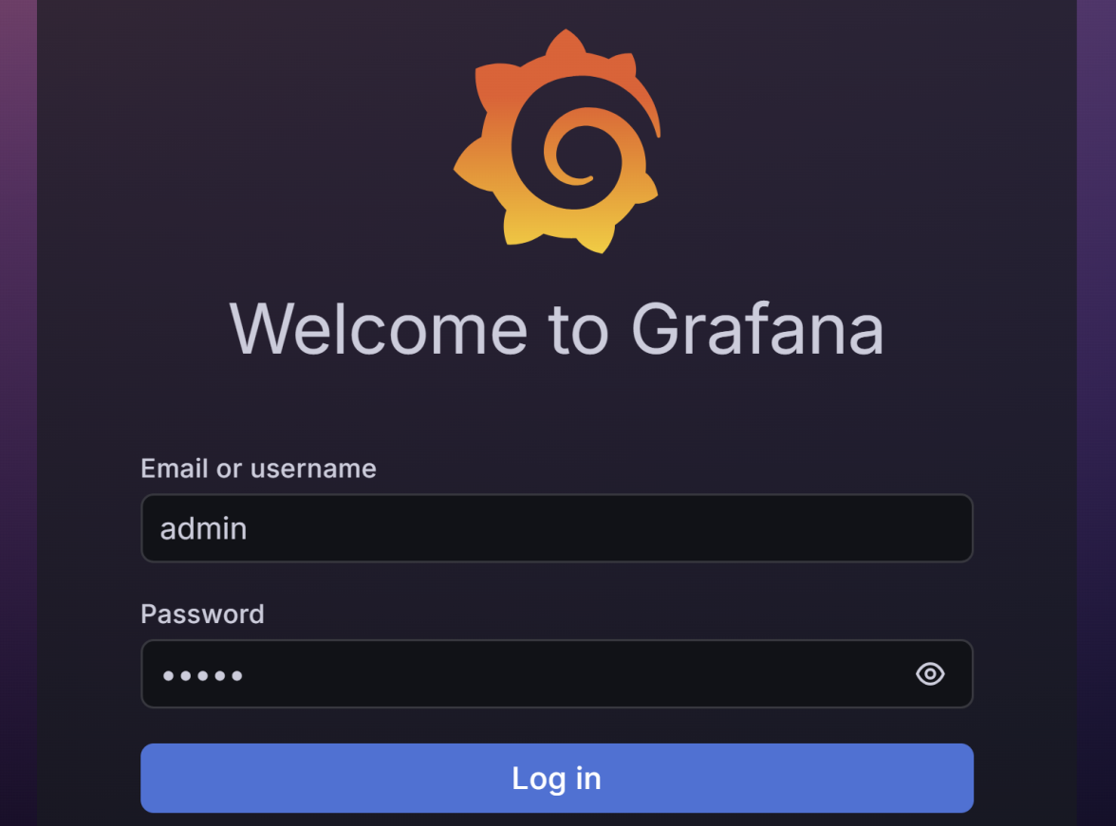
4. Log in the Grafana Server
http://20.253.214.16:9091/login
admin / admin

Slide 36
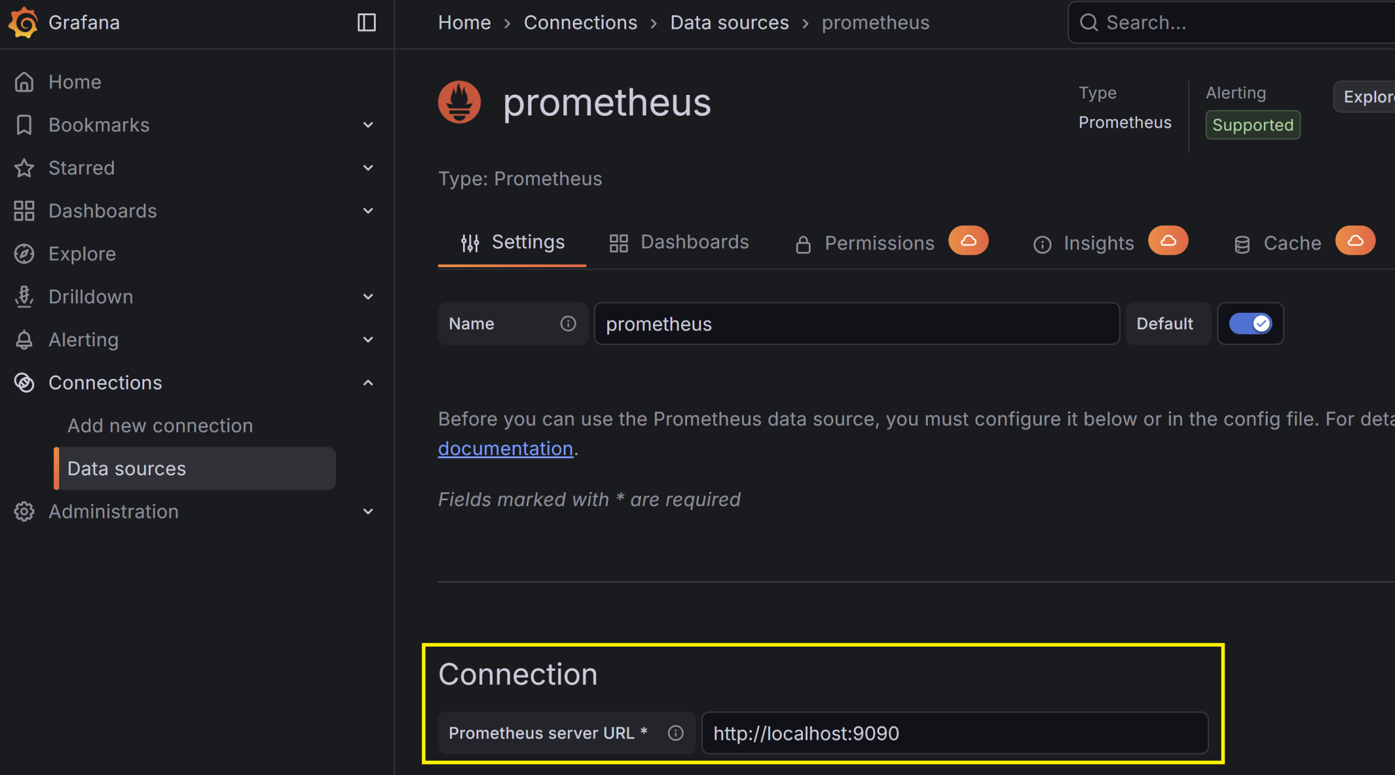
5. Add a Data Source

Slide 37
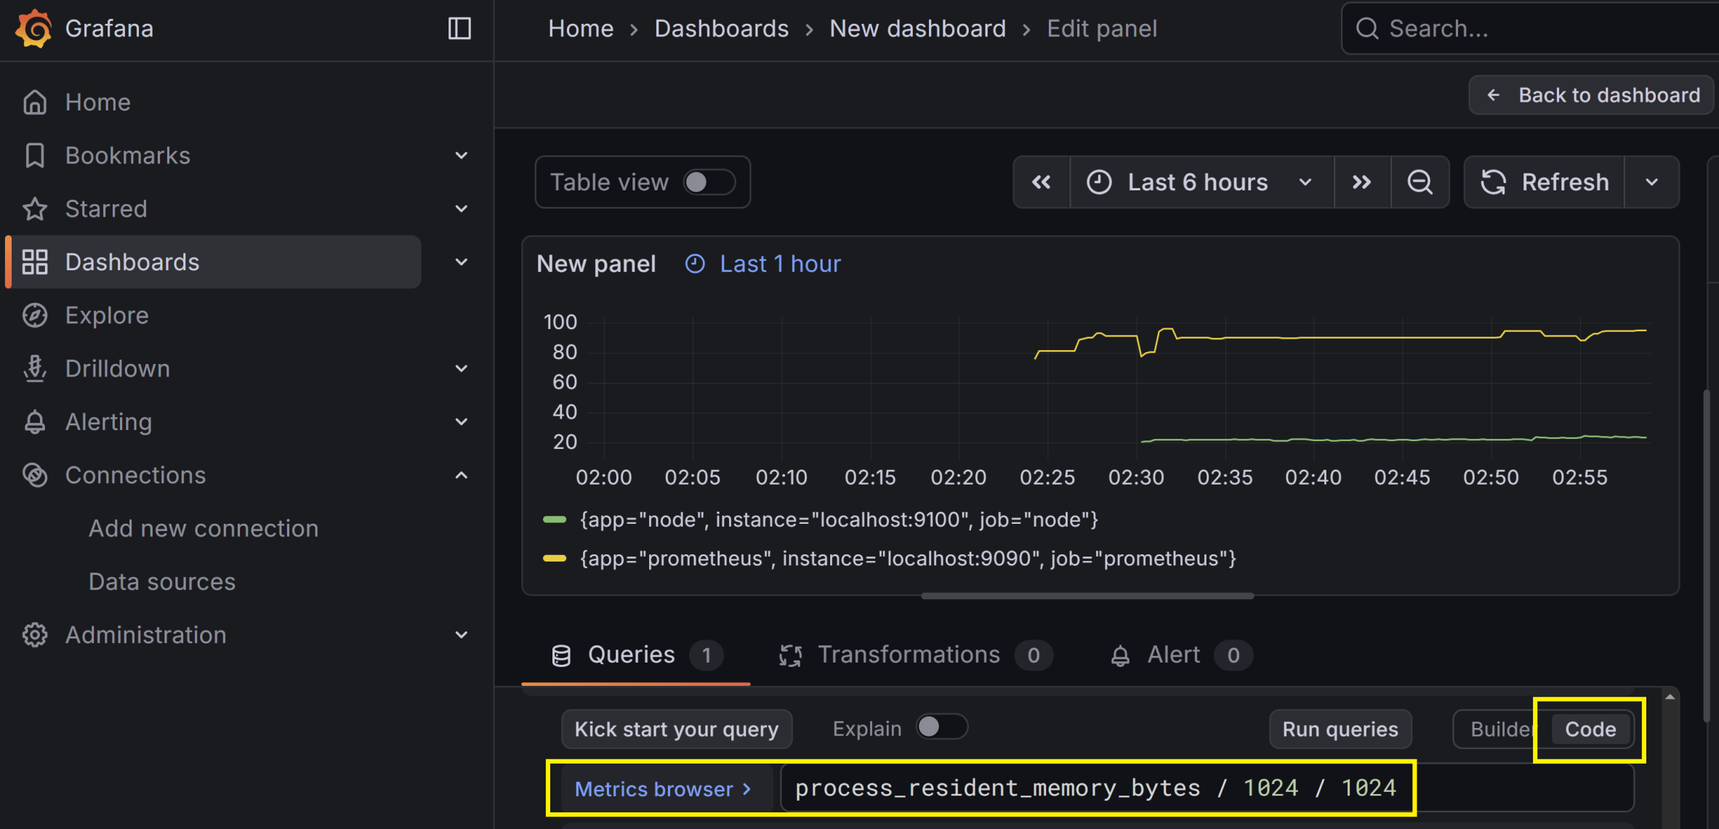
6. Build a Dashboard

Slide 38
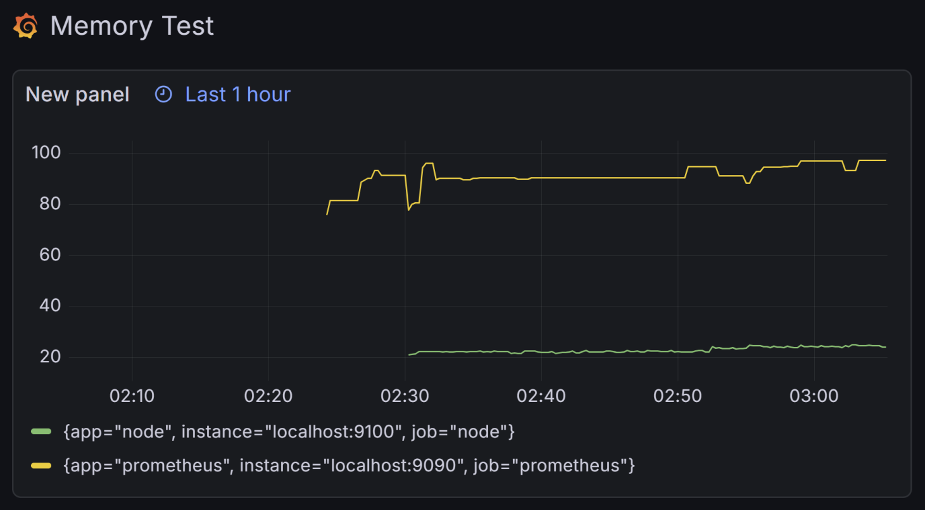
7. Share a Dashboard
http://20.253.214.16:9091/public-dashboards/0a62bde470c7430ebba5da096fd697fd

Slide 40
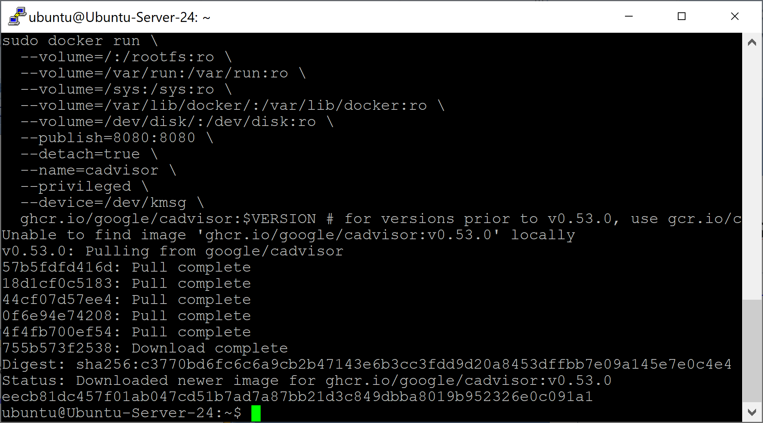
1. Run cAdvisor with Docker
https://github.com/google/cadvisor

Slide 41
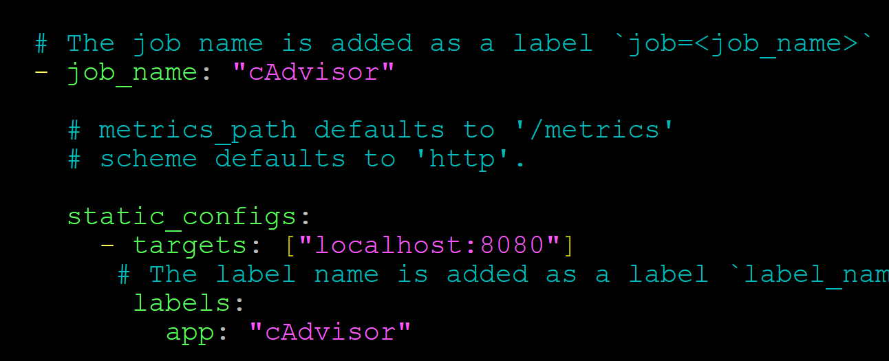
2. Add cAdvisor to Prometheus

Slide 42
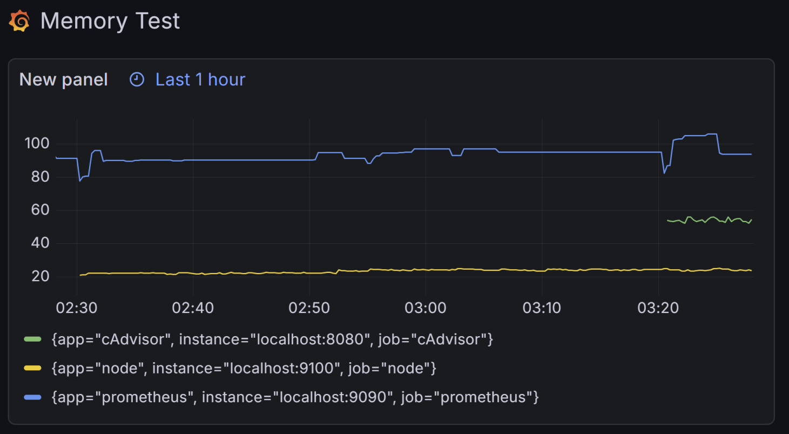
3. Review the Memory Dashboard

Slide 44
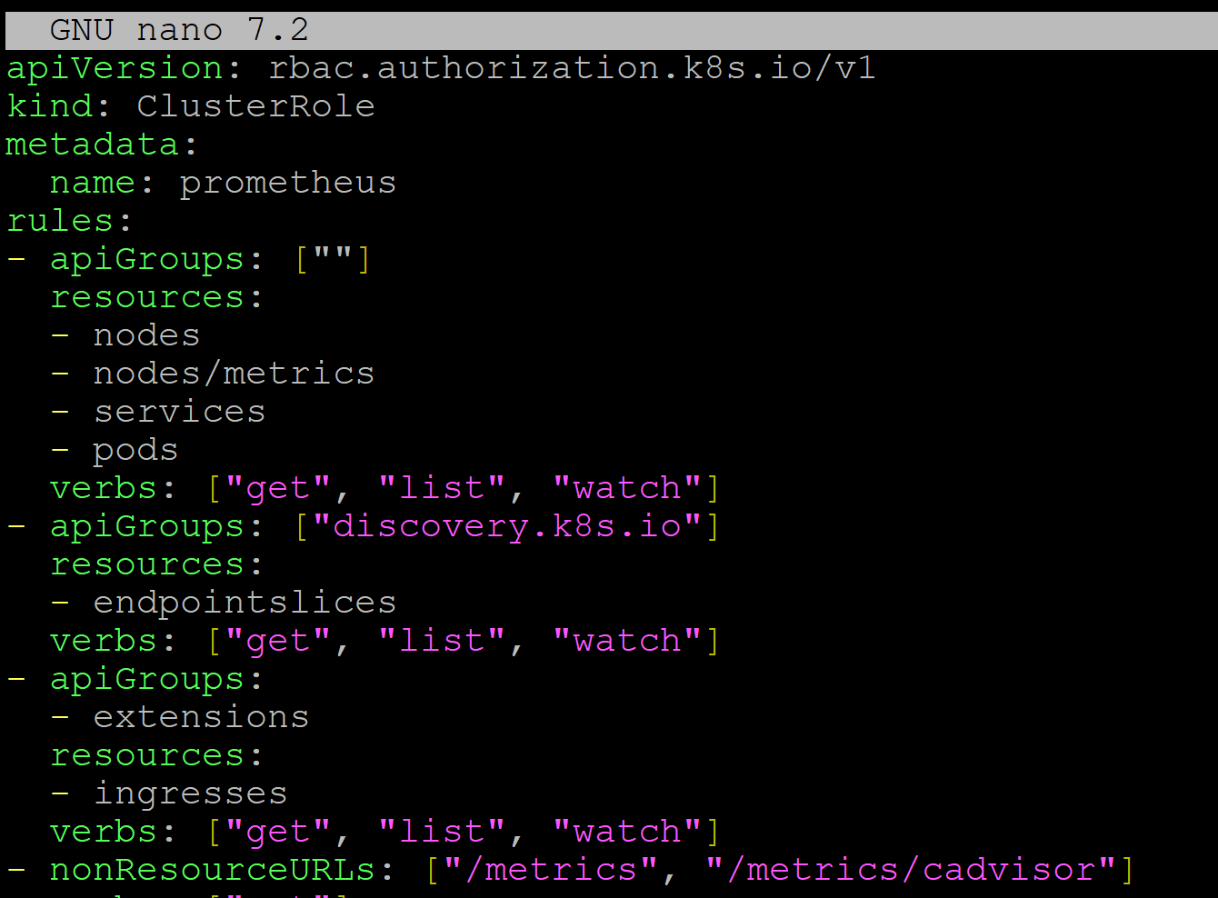
1. Prepare k8s Prometheus Deployment
nano prometheus-deployment.yml

Slide 45
2. Deploy Prometheus
kubectl apply -f prometheus-deployment.yml
kubectl port-forward svc/prometheus 9090:9090 --address=0.0.0.0

Slide 46
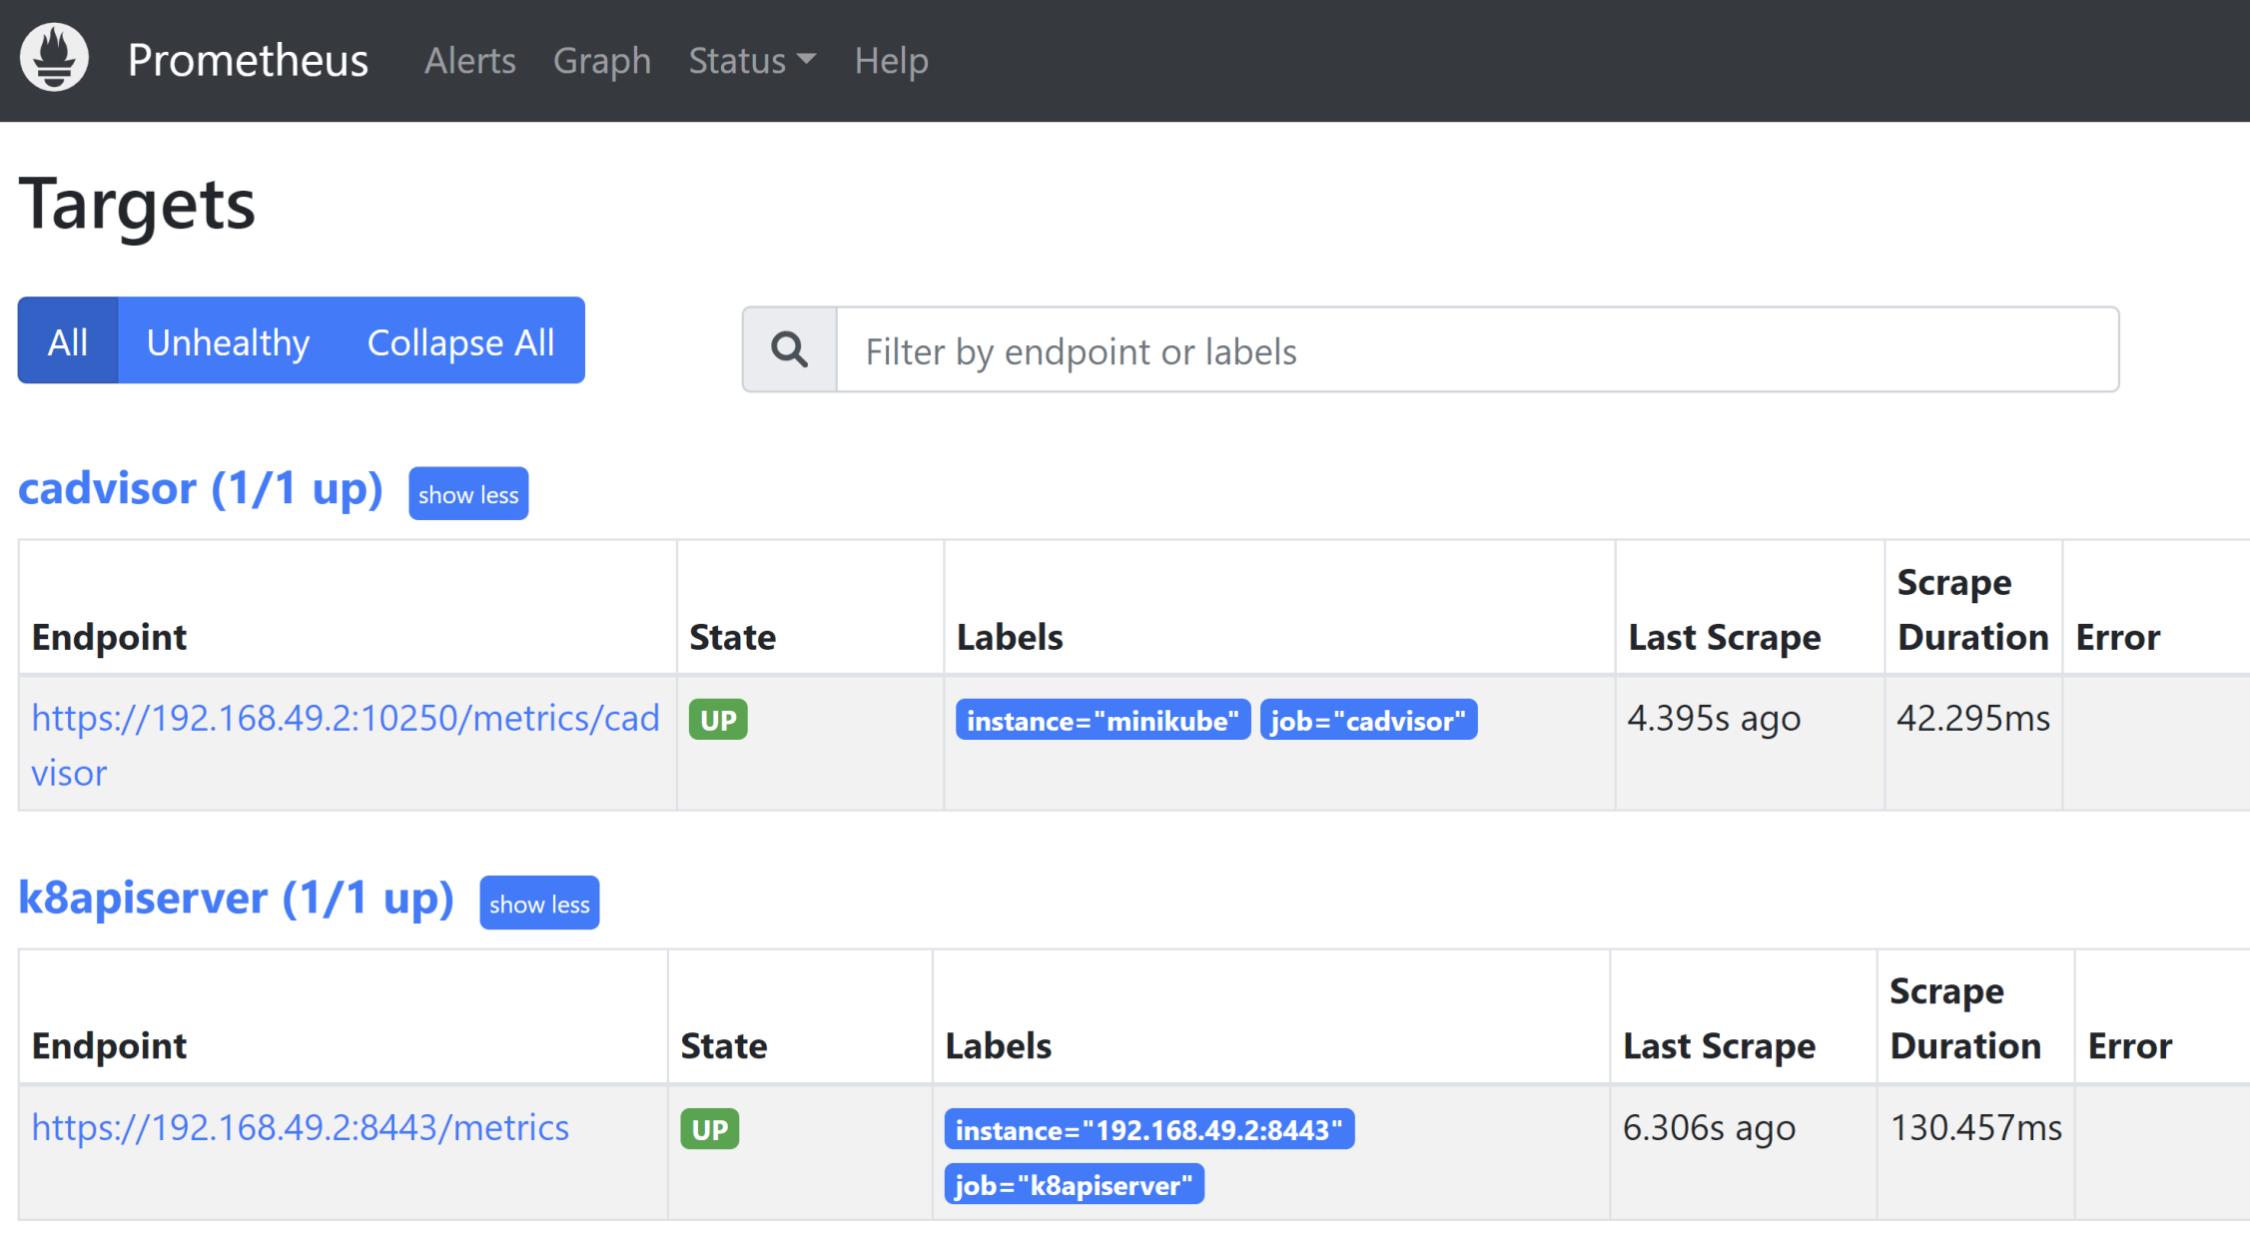
3. Open Prometheus
http://20.253.214.16:9090/targets

Slide 47
Service Discovery
There are currently six different types of Kubernetes service discoveries you can use with Prometheus, namely node, endpoints, endpointslice, service, pod, and ingress.
Prometheus uses the Kubernetes API to discover targets.

Slide 48
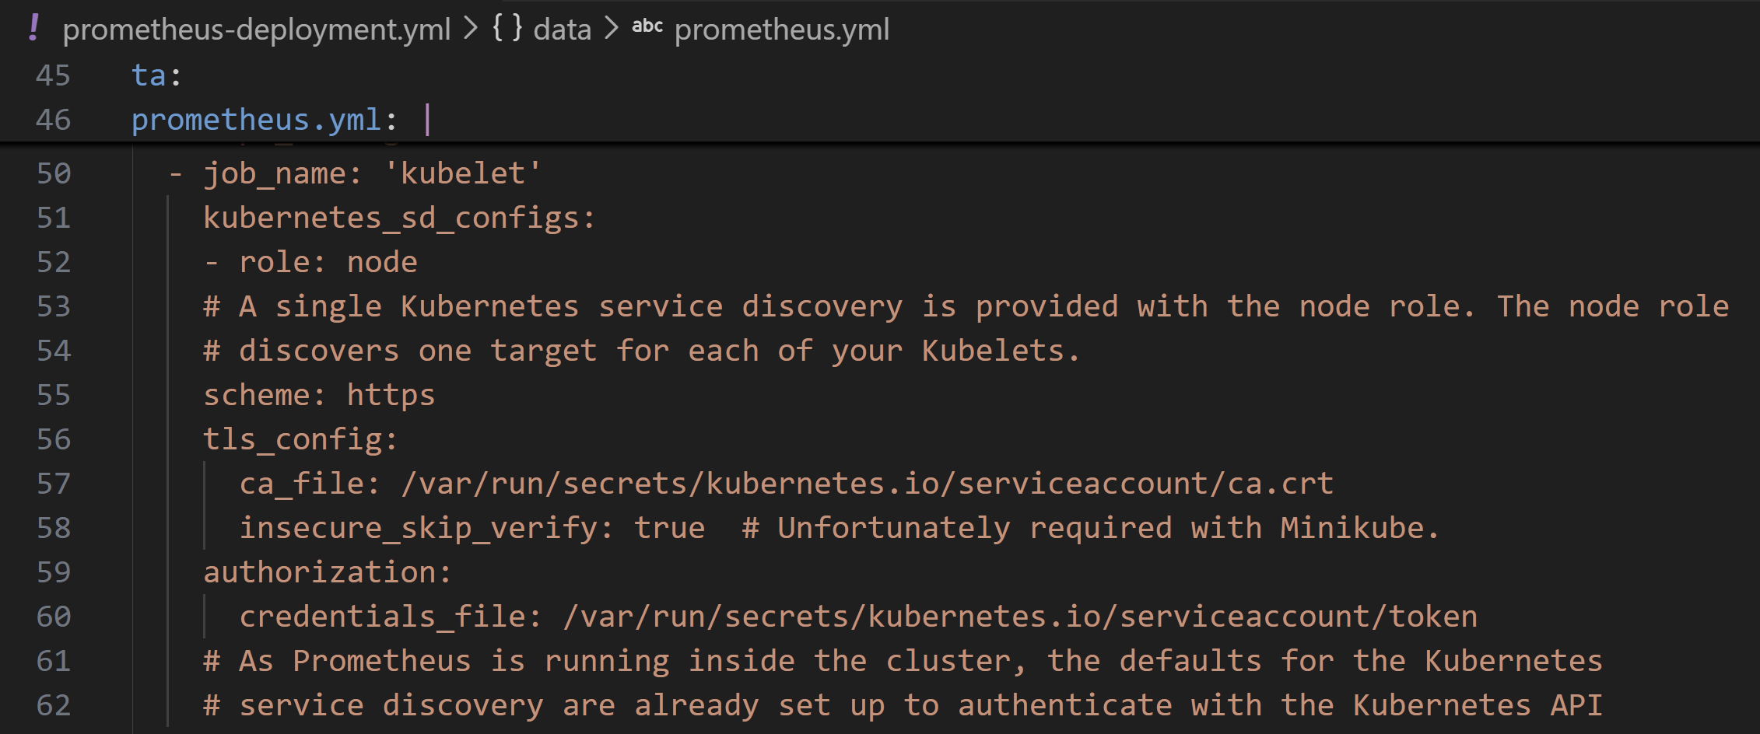
Node Service Discovery
Node service discovery is used to discover the nodes comprising the Kubernetes cluster, and you will use it to monitor the infrastructure around Kubernetes.
The kubelet is the name of the agent that runs on each node, and you should scrape it as part of monitoring the health of the Kubernetes cluster

Slide 49
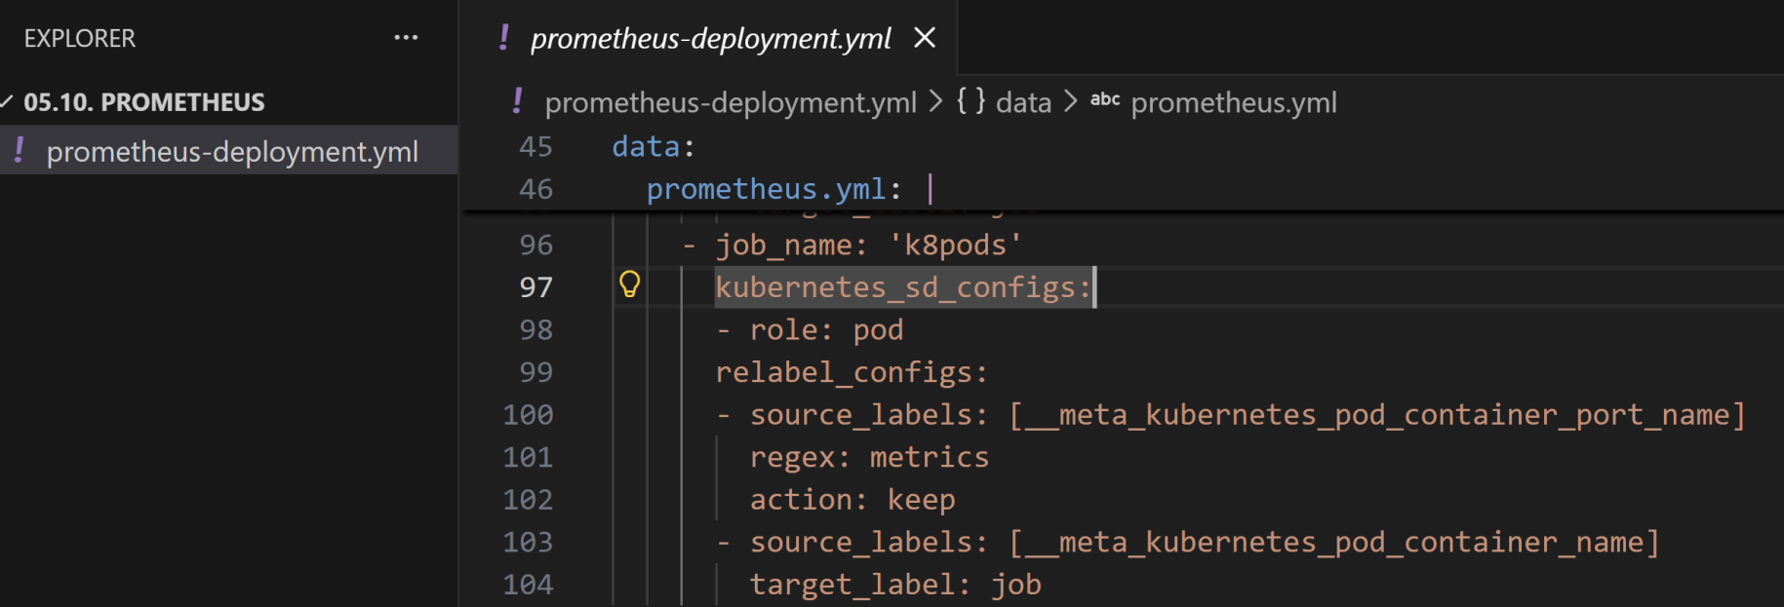
Pod Discovery
One of the components that comes with Minikube is kube-dns, which provides DNS services. Its pod has multiple ports, including a port named metrics that serves Prometheus metrics.
Discover all pod ports with the name metrics and to use the container name as the job label:

Slide 50
kube-state-metrics
Using Kubernetes service discovery you can have Prometheus scrape your applications and Kubernetes infrastructure, but this will not include metrics about what Kubernetes knows about your services, pods, deployments, and other resources.
This is because applications such as the Kubelet and Kubernetes API servers should expose information about their own performance, not dump their internal data structures.
Instead, you would obtain such metrics from another endpoint, or if that doesn’t exist, have an exporter that extracts the relevant information.
For Kubernetes, kube-state-metrics is that exporter.

Slide 51
How kube-state-metrics works
https://github.com/kubernetes/kube-state-metrics
kube-state-metrics (KSM) is a simple service that listens to the Kubernetes API server and generates metrics about the state of the objects.
kube-state-metrics is about generating metrics from Kubernetes API objects without modification.
Components like kubelets and control-plane services expose system performance metrics, but they don't translate Kubernetes API state into flat metrics Prometheus can scrape.
kube-state-metrics bridges that gap by watching the API and exporting states in Prometheus format.

Slide 52
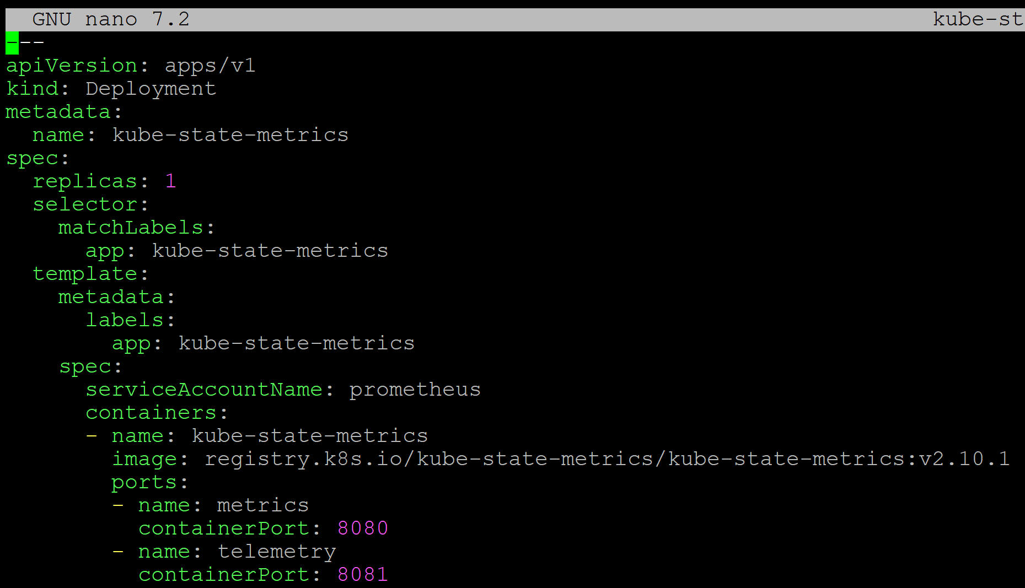
4. Prepare KSM Deployment
nano kube-state-metrics.yml

Slide 53
5. Deploy KSM
kubectl apply -f kube-state-metrics.yml
kubectl port-forward svc/kube-state-metrics 9090:9090 --address=0.0.0.0

Slide 54
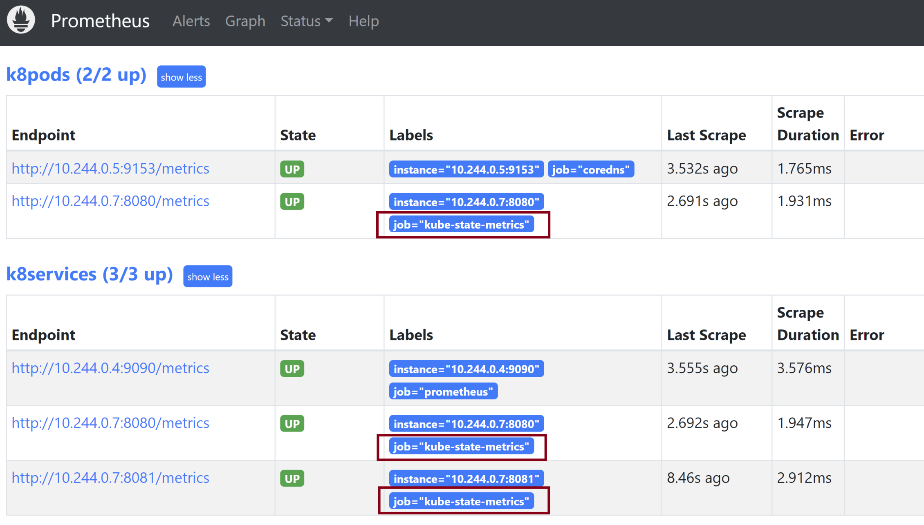
6. Open Prometheus
http://20.253.214.16:9090/targets

Slide 56
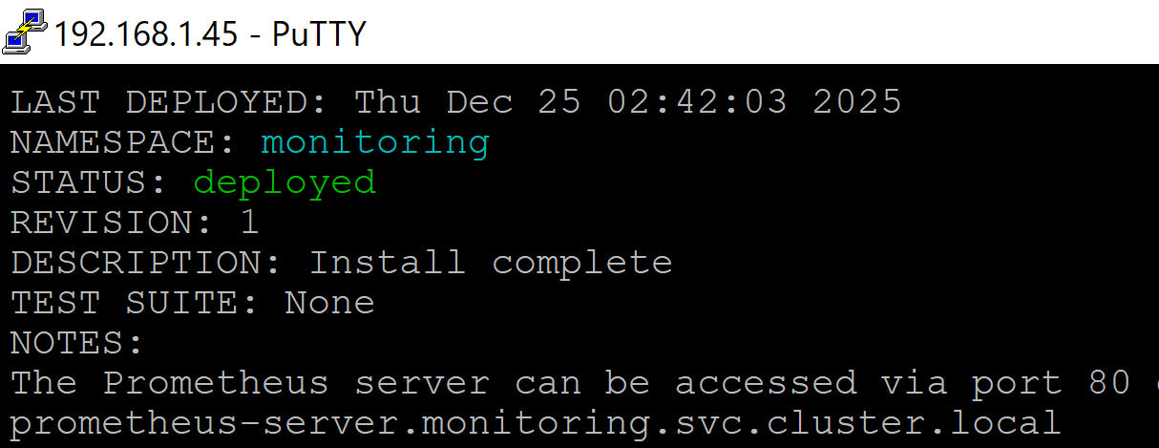
1. Deploy Prometheus using Helm
https://devopscube.com/setup-prometheus-helm-chart/
helm repo add prometheus-community https://prometheus-community.github.io/helm-charts
helm search repo prometheus-community
kubectl create namespace monitoring
helm upgrade -i prometheus prometheus-community/prometheus --namespace monitoring --create-namespace --set alertmanager.persistence.storageClass=standard --set server.persistentVolume.storageClass=standard

Slide 57
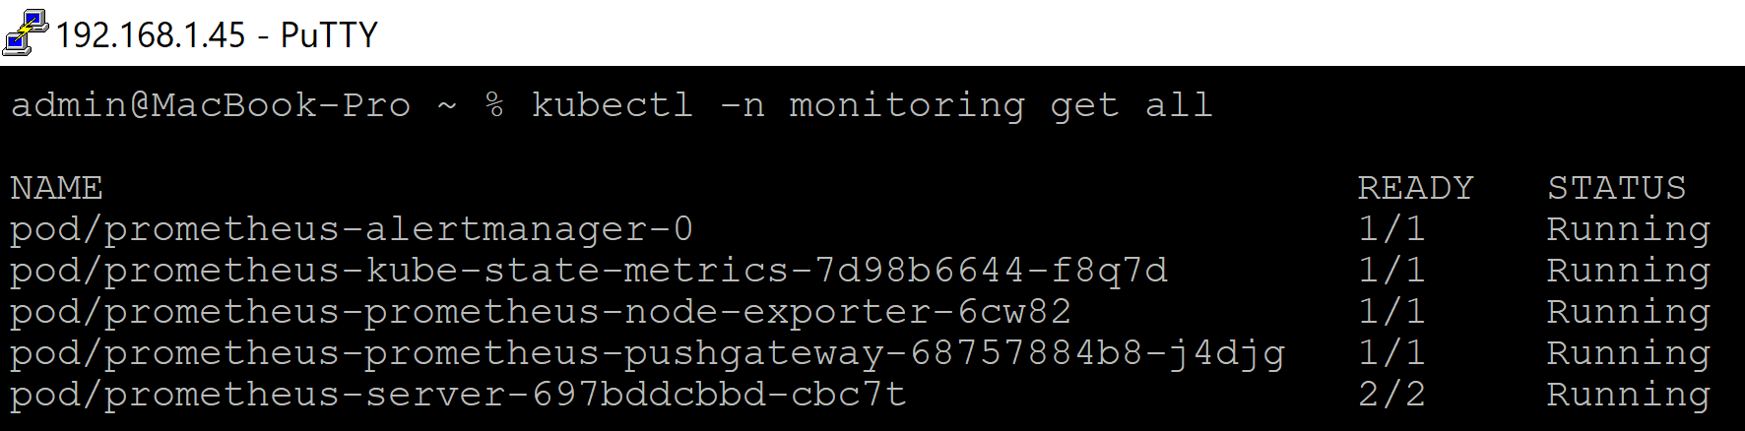
2. Test the Deployment
kubectl -n monitoring get all
export POD_NAME=$(kubectl get pods --namespace monitoring -l "app.kubernetes.io/name=prometheus,app.kubernetes.io/instance=prometheus" -o jsonpath="{.items[0].metadata.name}")
kubectl --namespace monitoring port-forward --address 0.0.0.0 $POD_NAME 9090
# Open: http://192.168.1.45:9090

Slide 58
3. Deploy kube-state-metrics
git clone https://github.com/kubernetes/kube-state-metrics.git
kubectl apply -f kube-state-metrics/examples/standard
kubectl get deployments kube-state-metrics -n kube-system

Slide 60
OpenTelemetry
https://opentelemetry.io/docs/what-is-opentelemetry/
OpenTelemetry consists of the following major components:
A specification for all components
A standard protocol that defines the shape of telemetry data

Slide 62
Elastic Observability
https://www.elastic.co/docs/solutions/observability
Elastic Observability provides unified observability across applications and infrastructure.
It combines logs, metrics, application traces, user experience data, and more into a single, integrated platform.
This consolidation allows for powerful, cross-referenced analysis, enabling teams to move from detecting issues to understanding their root causes quickly and efficiently.
By leveraging the search and analytics capabilities of Elasticsearch, it offers a holistic view of system behavior.
Elastic Observability embraces open standards like OpenTelemetry for flexible data collection, and offers scalable, cost-efficient data retention with tiered storage.

Slide 63
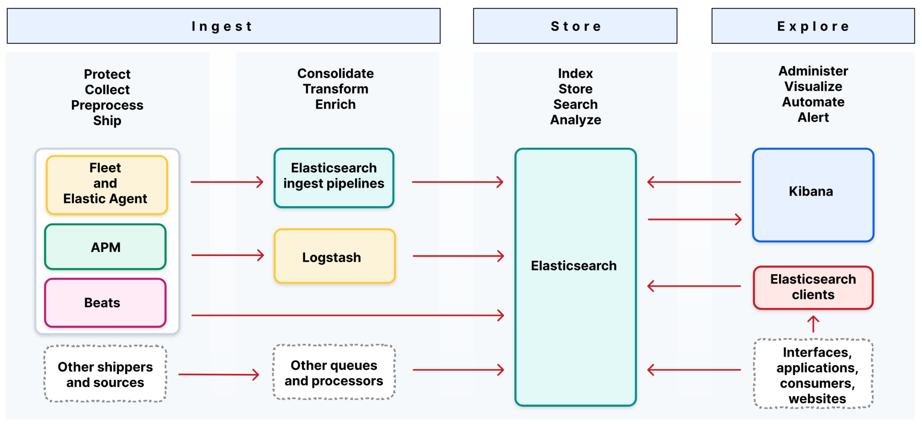
The Elastic Stack
https://www.elastic.co/docs/get-started/the-stack

Slide 64
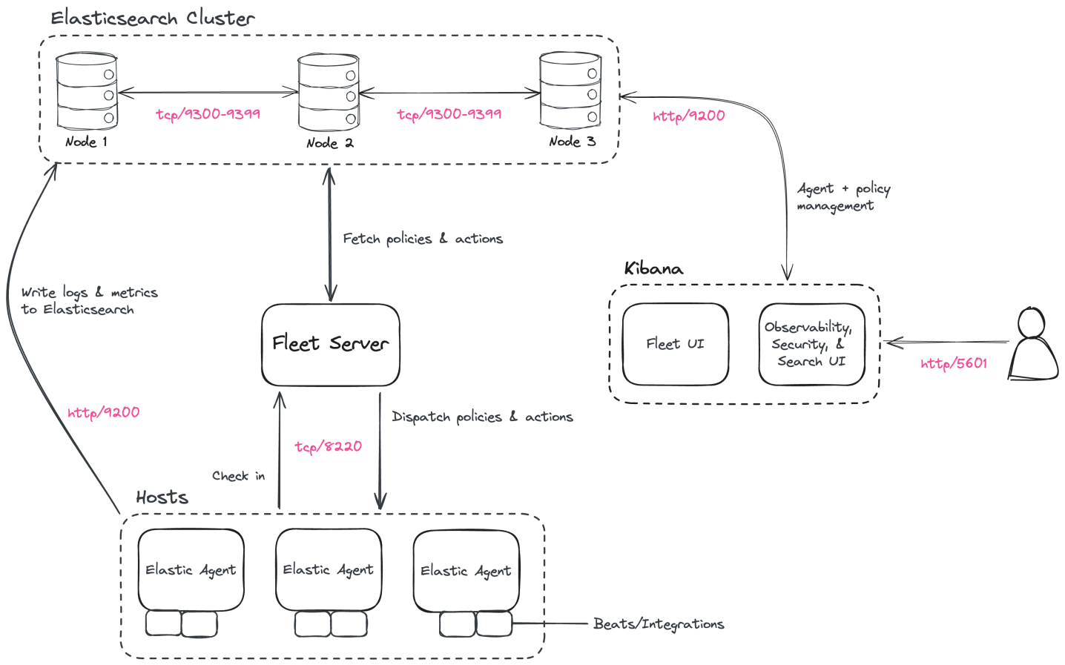
Deployment Architecture
https://www.elastic.co/docs/deploy-manage/deploy/self-managed/tutorial-self-managed-install

Slide 65
1. Create an Observability Project
https://www.elastic.co/docs/solutions/observability/apm/get-started
An Elastic Observability Serverless project allows you to run Elastic Observability Serverless in an autoscaled and fully-managed environment, where you don't have to manage the underlying Elasticsearch cluster or Kibana instances.

Slide 66
2. Register Application Performance Monitoring (APM)
https://www.elastic.co/docs/reference/apm/agents/dotnet/setup-asp-dot-net
Application Performance Monitoring (APM) collects in-depth performance metrics and errors from inside your application.
public class MyModule : IHttpModule
{
public void Init(HttpApplication app)
{
app.BeginRequest += OnBeginRequest;
app.EndRequest += OnEndRequest;
}
private void OnBeginRequest(object sender, EventArgs e)
{
var app = (HttpApplication)sender;
// Request has entered the ASP.NET pipeline.
}
...
IHttpModule.Init()
|
| subscribe
|
HttpApplication.BeginRequest
|
| authentication
| authorization
| handler execution
| ...
|
HttpApplication.EndRequest

Slide 67
How does the Agent work?
https://www.elastic.co/docs/reference/apm/agents/dotnet
The agent auto-instruments supported technologies and records interesting events, like HTTP requests and database queries.
To do this, it uses built-in capabilities of the instrumented frameworks like Diagnostic Source, an HTTP module for IIS, or IDbCommandInterceptor for Entity Framework.
This means that for the supported technologies, there are no code changes required beyond enabling auto-instrumentation.

Slide 68
3. Configure and Test APM
https://www.elastic.co/docs/reference/apm/agents/dotnet/configuration-on-asp-net
curl.exe -i -H "Authorization: ApiKey RW…w" "https://my-observability-project-cfb03b.apm.us-west1.gcp.elastic.cloud/"

Slide 69
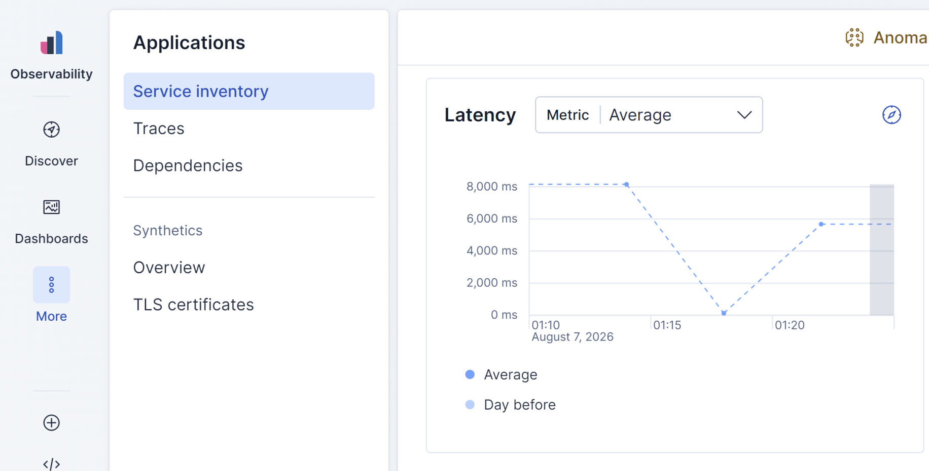
4. View Telemetry on Elastic Cloud

Slide 70
5. Register Host Monitoring
https://www.elastic.co/docs/solutions/observability/get-started/quickstart-monitor-hosts-with-elastic-agent
To scan your host, you'll run an auto-detection script that downloads and installs Elastic Agent, which is used to collect observability data from the host and send it to Elastic.

Slide 71
6. Register Kubernetes Monitoring
https://www.elastic.co/docs/solutions/observability/get-started/quickstart-unified-kubernetes-observability-with-elastic-distributions-of-opentelemetry-edot
Deploy the OpenTelemetry Operator and Elastic Agents using the kube-stack Helm chart with the provided values.yaml file.

Slide 72
7. Deploy Self-managed Cluster
https://www.elastic.co/docs/deploy-manage/deploy/self-managed
If you deploy a self-managed cluster, then you have complete control and responsibility over every aspect of your Elastic deployment.
Elasticsearch is the distributed search and analytics engine, scalable data store, and vector database at the heart of all Elastic solutions.
After you deploy Elasticsearch, you can install Kibana. Kibana provides the user interface for all Elastic solutions.

Slide 73
Prometheus vs. Elastic Observability
Prometheus tells you that your application is slow. Elastic APM is designed to tell you why it is slow.
Prometheus is used for operational metrics, while Elastic is used when request-level diagnostics, traces, exceptions, and log correlation are needed.
They are not mutually exclusive.
Elastic now also supports native Prometheus ingestion and PromQL, so a Prometheus-based metrics architecture can coexist with Elastic Observability.

Slide 75
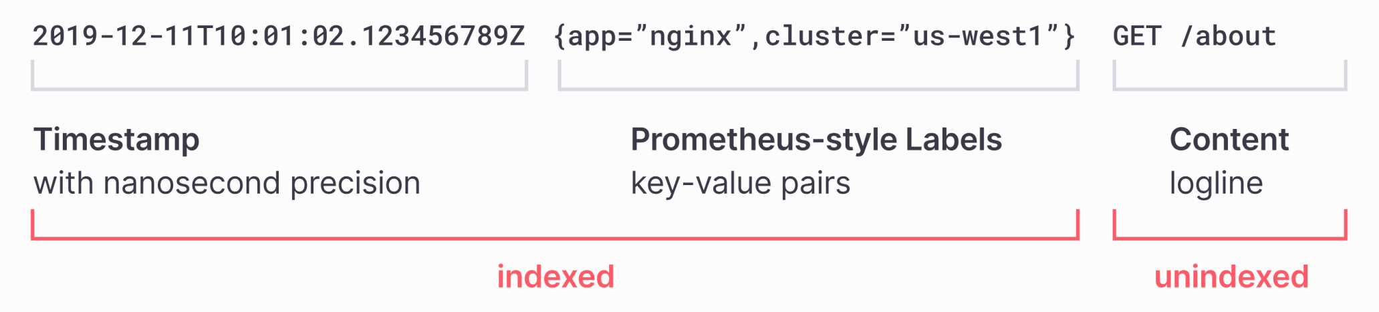
Grafana Loki
https://grafana.com/oss/loki/
Loki is a horizontally scalable, highly available, multi-tenant log aggregation system inspired by Prometheus.
It is designed to be very cost effective and easy to operate.
It does not index the contents of the logs, but rather a set of labels for each log stream.

Slide 76
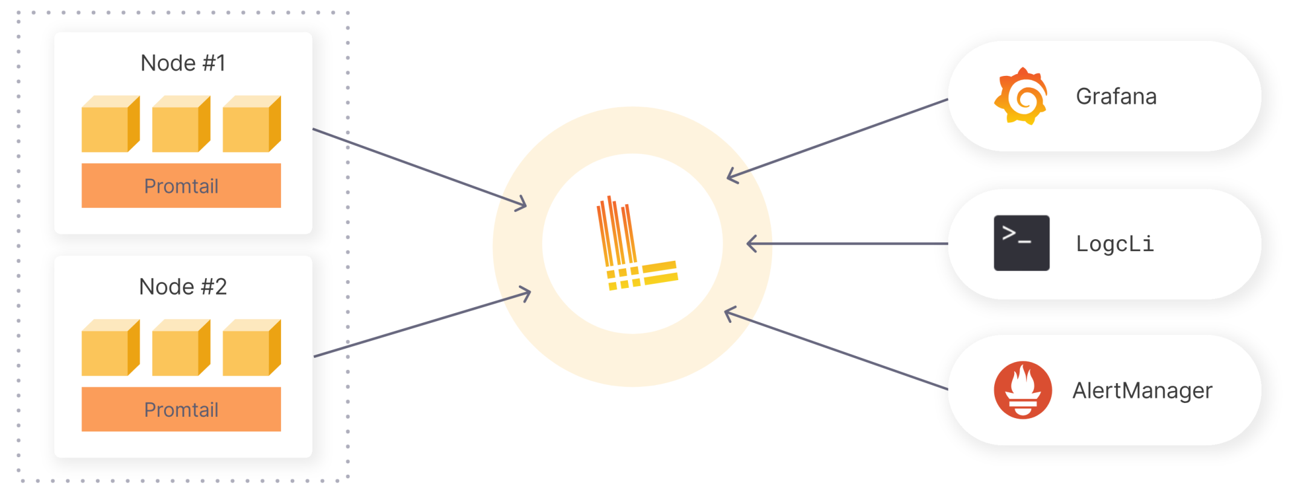
How does Grafana Loki work?
Promtail is a logs collector built specifically for Loki. It uses the same service discovery as Prometheus and includes analogous features for labeling, transforming, and filtering logs before ingestion into Loki.

Slide 77
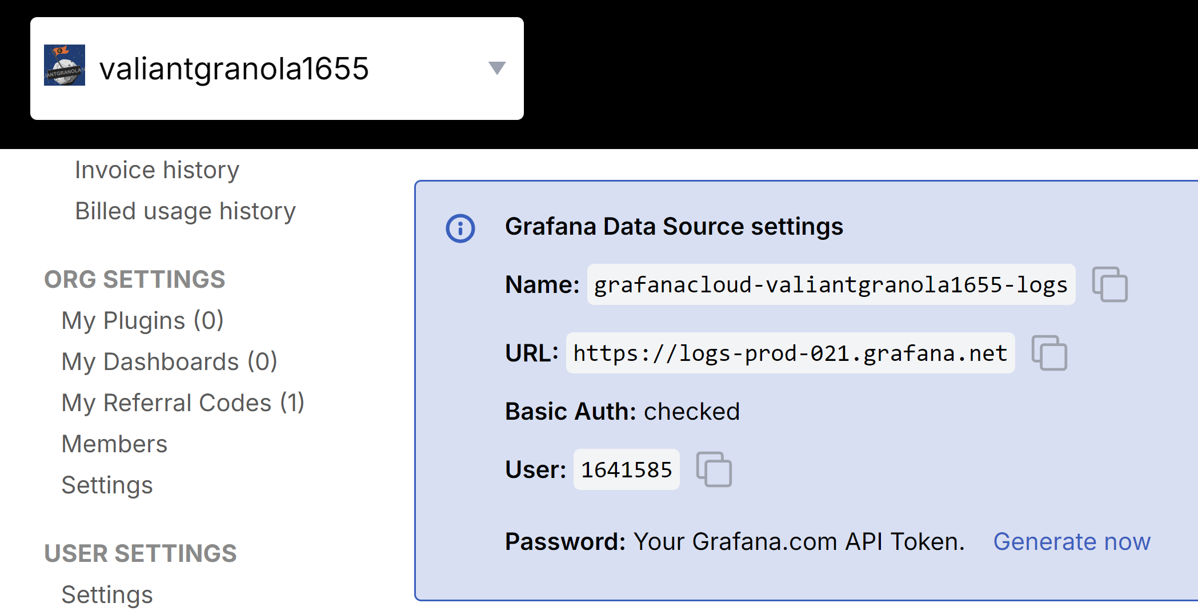
1. Send Logs to Loki
https://grafana.com/orgs/valiantgranola1655/hosted-logs/1641585#sending-logs

Slide 78
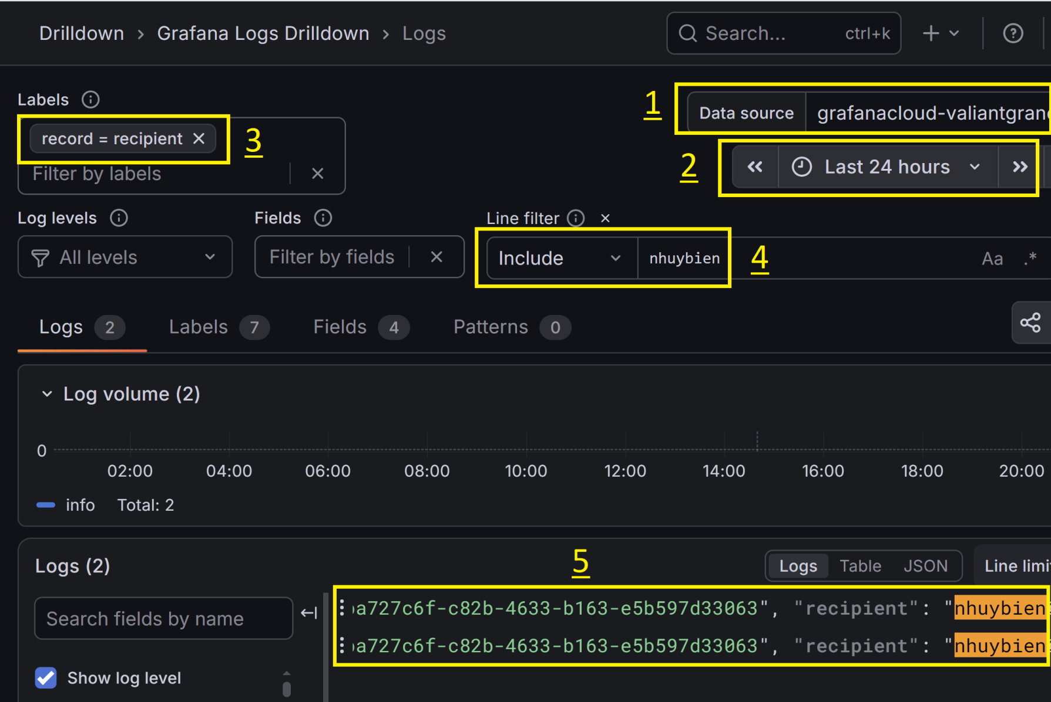
2. View Loki Logs
https://valiantgranola1655.grafana.net/a/grafana-lokiexplore-app/explore

Slide 79
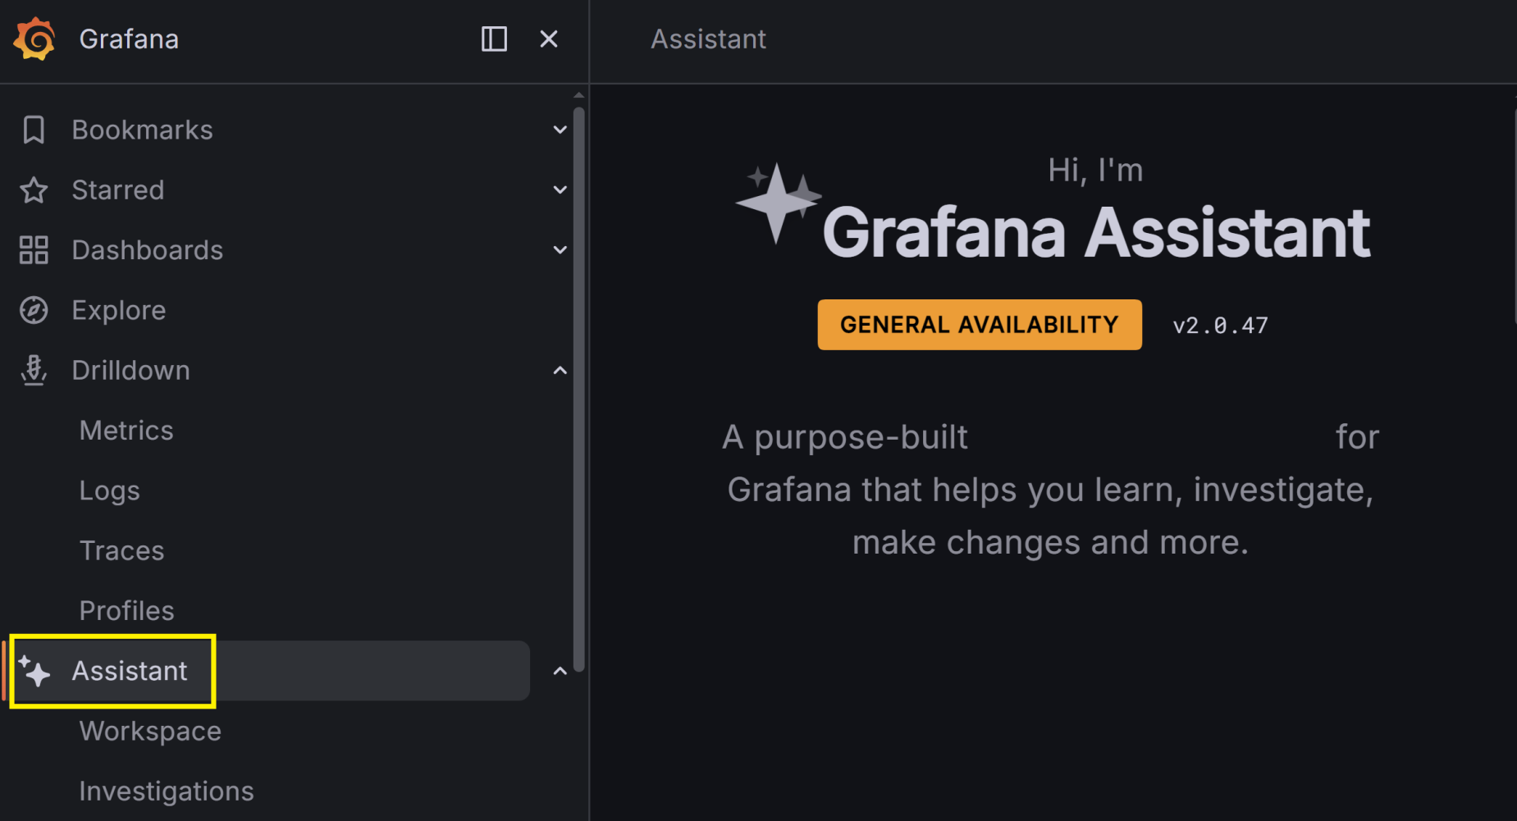
3. Open Assistant
https://valiantgranola1655.grafana.net/a/grafana-assistant-app

Slide 80
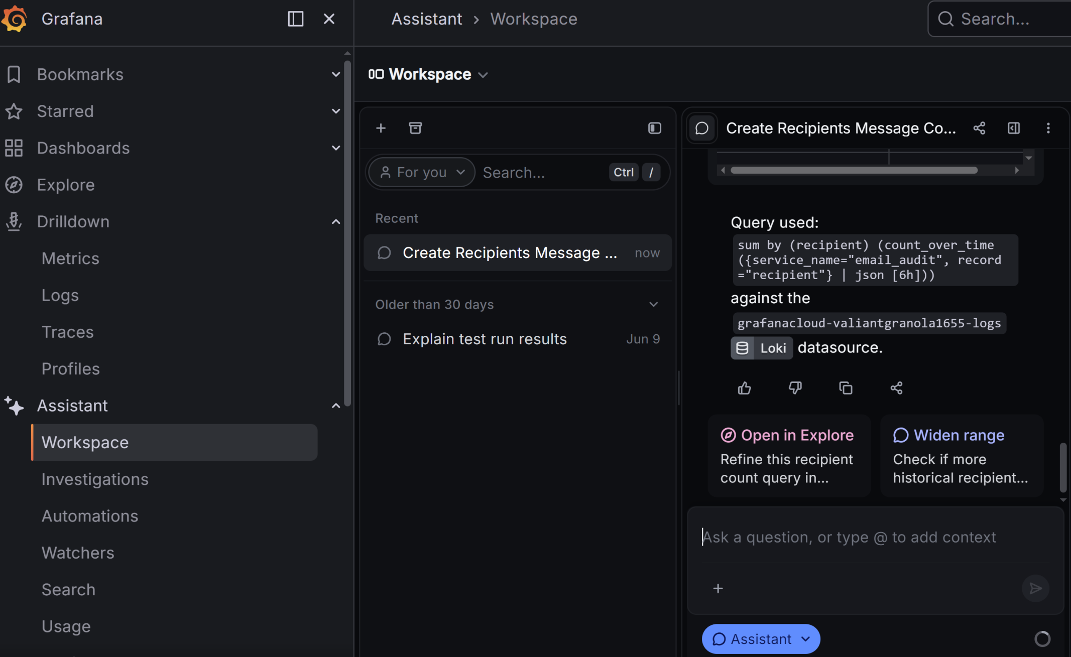
4. Use Assistant to Build Table
https://valiantgranola1655.grafana.net/a/grafana-assistant-app

Slide 81
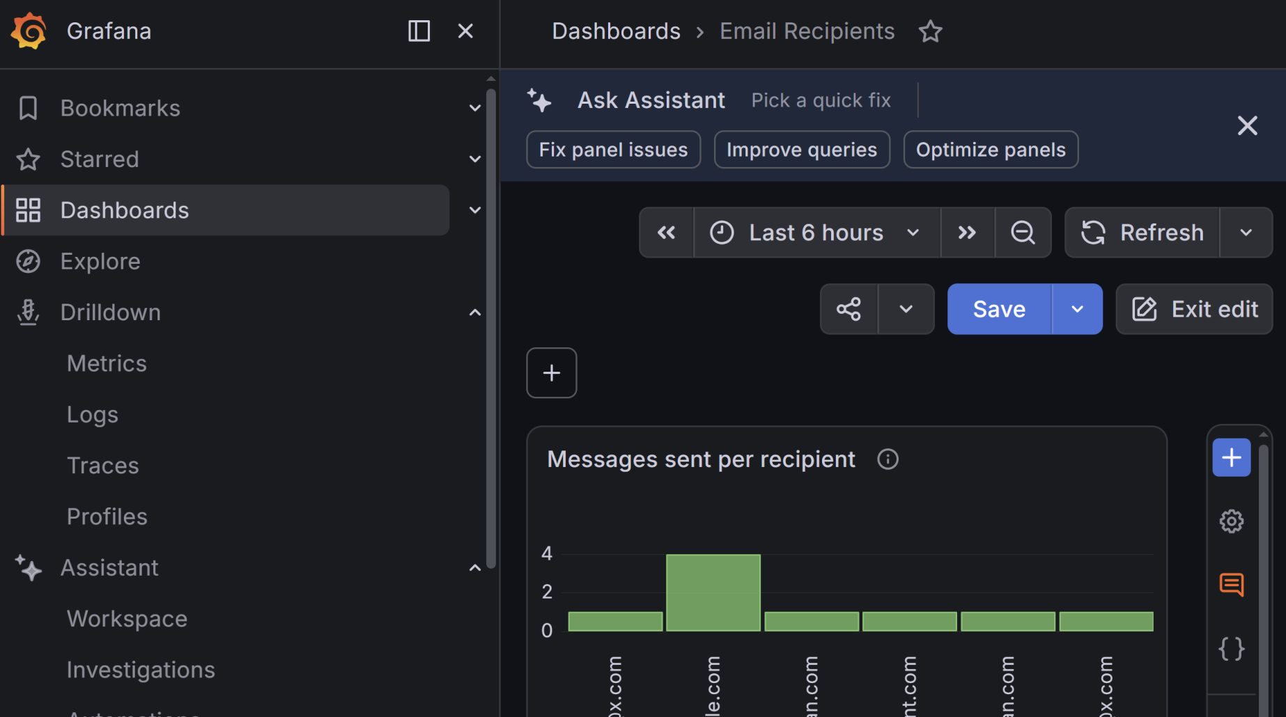
5. Use Assistant to Build a Chart
https://valiantgranola1655.grafana.net/d/tepzrv5/email-recipients

Slide 83
Chronosphere
https://chronosphere.io/
Chronosphere is the world’s most reliable observability platform for microservices and containers.

Slide 84
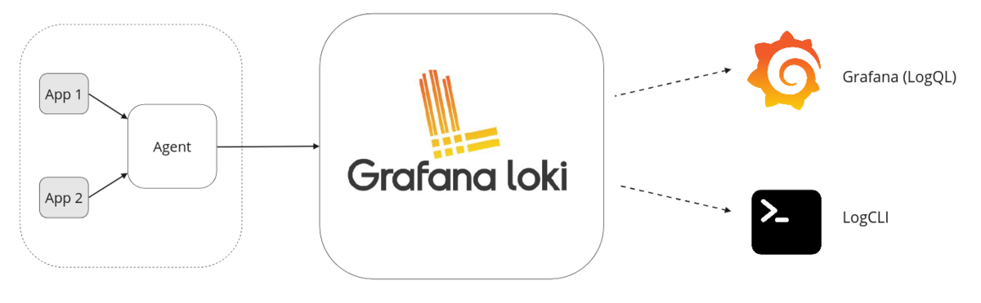
Loki
https://grafana.com/docs/loki/latest/get-started/overview/
Loki is a horizontally-scalable, highly-available, multi-tenant log aggregation system inspired by Prometheus.
Loki differs from Prometheus by focusing on logs instead of metrics, and collecting logs via push, instead of pull.

Slide 85
InfluxDB
https://www.influxdata.com/products/influxdb/
Most databases weren't built for time series.
InfluxDB 3 Core is built to handle continuous, high-resolution data with precision and speed.

Slide 86

Thank You & See You Again

